Slide 1
Kubernetes in Action
Part VI
2028.08.25

Slide 2
StatefulSets
Deploying Replicated Stateful Applications

Slide 3
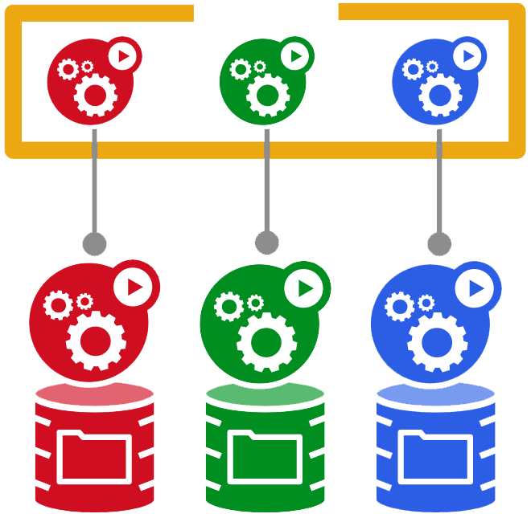
Replicating Stateful Pods(1/5)
StatefulSets :
  ReplicaSets create multiple pod replicas from a single pod template. These replicas don’t differ from each other, apart from their name and IP address. If the pod template includes a volume, which refers to a specific PersistentVolumeClaim, all replicas of the ReplicaSet will use the exact same PersistentVolumeClaim and therefore the same PersistentVolume bound by the claim (shown in the following figure).
  Because the reference to the claim is in the pod template, which is used to stamp out multiple pod replicas, you can’t make each replica use its own separate PersistentVolumeClaim. You can’t use a ReplicaSet to run a distributed data store, where each instance needs its own separate storage—at least not by using a single ReplicaSet. To be honest, none of the API objects you’ve seen so far make running such a data store possible. You need something else :

Slide 4
Replicating Stateful Pods(2/5)
Running Multiple Replicas with Separate Storage for Each :
  How does one run multiple replicas of a pod and have each pod use its own storage volume? ReplicaSets create exact copies (replicas) of a pod; therefore you can’t use them for these types of pods. What can you use?
  You could create pods manually and have each of them use its own PersistentVolumeClaim, but because no ReplicaSet looks after them, you’d need to manage them manually and recreate them when they disappear (as in the event of a node failure). Therefore, this isn’t a viable option.
  Instead of creating pods directly, you could create multiple ReplicaSets—one for each pod with each ReplicaSet’s desired replica count set to one, and each ReplicaSet’s pod template referencing a dedicated PersistentVolumeClaim (as shown in the following figure).
  Although this takes care of the automatic rescheduling in case of node failures or accidental pod deletions, it’s much more cumbersome compared to having a single ReplicaSet. For example, think about how you’d scale the pods in that case. You couldn’t change the desired replica count—you’d have to create additional ReplicaSets instead.
  Using multiple ReplicaSets is therefore not the best solution. But could you maybe use a single ReplicaSet and have each pod instance keep its own persistent state, even though they’re all using the same storage volume?

Slide 5
Replicating Stateful Pods(3/5)
Running Multiple Replicas with Separate Storage for Each :
  A trick you can use is to have all pods use the same PersistentVolume, but then have a separate file directory inside that volume for each pod (this is shown in the following figure).
  Because you can’t configure pod replicas differently from a single pod template, you can’t tell each instance what directory it should use, but you can make each instance automatically select (and possibly also create) a data directory that isn’t being used by any other instance at that time. This solution does require coordination between the instances, and isn’t easy to do correctly. It also makes the shared storage volume the bottleneck.

Slide 6
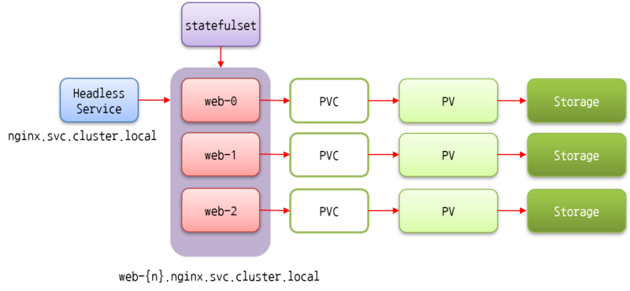
Replicating Stateful Pods(4/5)
Providing a Stable Identity for Each Pod :
  In addition to storage, certain clustered applications also require that each instance has a long-lived stable identity. Pods can be killed from time to time and replaced with new ones. When a ReplicaSet replaces a pod, the new pod is a completely new pod with a new hostname and IP, although the data in its storage volume may be that of the killed pod. For certain apps, starting up with the old instance’s data but with a completely new network identity may cause problems.
  Why do certain apps mandate a stable network identity? This requirement is fairly common in distributed stateful applications. Certain apps require the administrator to list all the other cluster members and their IP addresses (or hostnames) in each member’s configuration file. But in Kubernetes, every time a pod is rescheduled, the new pod gets both a new hostname and a new IP address, so the whole application cluster would have to be reconfigured every time one of its members is rescheduled.

Slide 7
Replicating Stateful Pods(5/5)
Providing a Stable Identity for Each Pod :
  A trick you can use to work around this problem is to provide a stable network address for cluster members by creating a dedicated Kubernetes Service for each individual member. Because service IPs are stable, you can then point to each member through its service IP (rather than the pod IP) in the configuration.
  This is similar to creating a ReplicaSet for each member to provide them with individual storage, as described previously. Combining these two techniques results in the setup shown in the following figure (an additional service covering all the cluster members is also shown, because you usually need one for clients of the cluster).
  The solution is not only ugly, but it still doesn’t solve everything. The individual pods can’t know which Service they are exposed through (and thus can’t know their stable IP), so they can’t self-register in other pods using that IP.

Slide 8
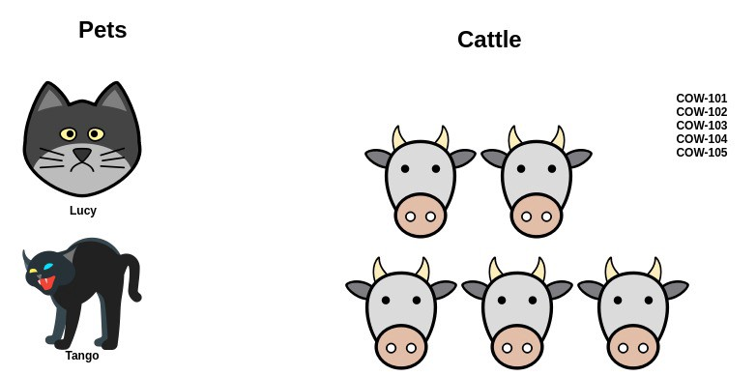
Understanding StatefulSets(1/10)
Comparing StatefulSets and ReplicaSets :
  Instead of using a ReplicaSet to run the previous types of pods, you create a StatefulSet resource, which is specifically tailored to applications where instances of the application must be treated as non-fungible individuals, with each one having a stable name and state.
  To understand the purpose of StatefulSets, it’s best to compare them to ReplicaSets or ReplicationControllers.
  NOTE : StatefulSets were initially called PetSets. That name comes from the pets vs. cattle analogy.
  We tend to treat our app instances as pets, where we give each instance a name and take care of each instance individually. But it’s usually better to treat instances as cattle and not pay special attention to each individual instance. This makes it easy to replace unhealthy instances without giving it a second thought, similar to the way a farmer replaces unhealthy cattle.
  Instances of a stateless app, for example, behave much like heads of cattle. It doesn’t matter if an instance dies—you can create a new instance and people won’t notice the difference.
  On the other hand, with stateful apps, an app instance is more like a pet. When a pet dies, you can’t go buy a new one and expect people not to notice. To replace a lost pet, you need to find a new one that looks and behaves exactly like the old one. In the case of apps, this means the new instance needs to have the same state and identity as the old one.

Slide 9
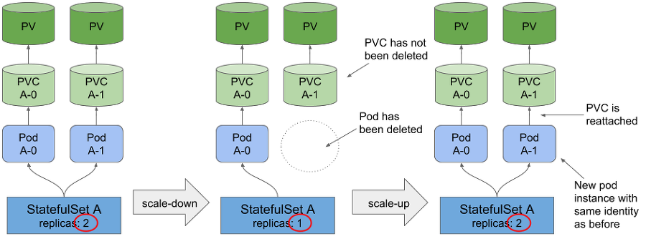
Understanding StatefulSets(2/10)
Comparing StatefulSets and ReplicaSets :
  Pod replicas managed by a ReplicaSet or ReplicationController are much like cattle. Because they’re mostly stateless, they can be replaced with a completely new pod replica at any time. Stateful pods require a different approach. When a stateful pod instance dies (or the node it’s running on fails), the pod instance needs to be resurrected on another node, but the new instance needs to get the same name, network identity, and state as the one it’s replacing. This is what happens when the pods are managed through a StatefulSet.
  A StatefulSet makes sure pods are rescheduled in such a way that they retain their identity and state. It also allows you to easily scale the number of pets up and down. A StatefulSet, like a ReplicaSet, has a desired replica count field that determines how many pets you want running at that time. Similar to ReplicaSets, pods are created from a pod template specified as part of the StatefulSet. But unlike pods created by ReplicaSets, pods created by the StatefulSet aren’t exact replicas of each other. Each can have its own set of volumes—in other words, storage (and thus persistent state)—which differentiates it from its peers. Pet(Stateful) pods also have a predictable (and stable) identity instead of each new pod instance getting a completely random one.

Slide 10
Understanding StatefulSets(3/10)
Providing a Stable Network Identity :
  Each pod created by a StatefulSet is assigned an ordinal index (zero-based), which is then used to derive the pod’s name and hostname, and to attach stable storage to the pod. The names of the pods are thus predictable, because each pod’s name is derived from the StatefulSet’s name and the ordinal index of the instance. Rather than the pods having random names, they’re nicely organized, as shown in the following figure.

Slide 11
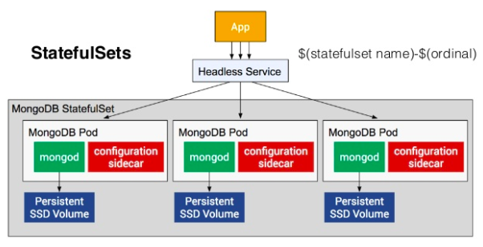
Understanding StatefulSets(4/10)
Providing a Stable Network Identity :
  Unlike regular pods, stateful pods sometimes need to be addressable by their hostname, whereas stateless pods usually don’t. After all, each stateless pod is like any other. When you need one, you pick any one of them. But with stateful pods, you usually want to operate on a specific pod from the group, because they differ from each other (they hold different state, for example).
  For this reason, a StatefulSet requires you to create a corresponding governing headless Service that’s used to provide the actual network identity to each pod. Through this Service, each pod gets its own DNS entry, so its peers and possibly other clients in the cluster can address the pod by its hostname. For example, if the governing Service belongs to the default namespace and is called “foo”, and one of the pods is called “A-0”, you can reach the pod through its fully qualified domain name, which is “a-0.foo.default.svc.cluster.local”. You can’t do that with pods managed by a ReplicaSet.
  You can also use DNS to look up all the StatefulSet’s pods’ names by looking up SRV records for the “foo.default.svc.cluster.local” domain.

Slide 12
Understanding StatefulSets(5/10)
Providing a Stable Network Identity :
  When a pod instance managed by a StatefulSet disappears (because the node the pod was running on has failed, it was evicted from the node, or someone deleted the pod object manually), the StatefulSet makes sure it’s replaced with a new instance—similar to how ReplicaSets do it. But in contrast to ReplicaSets, the replacement pod gets the same name and hostname as the pod that has disappeared (this distinction between ReplicaSets and StatefulSets is illustrated in the following figure).
The new pod isn’t necessarily scheduled to the same node, but as you learned early on, what node a pod runs on shouldn’t matter. This holds true even for stateful pods. Even if the pod is scheduled to a different node, it will still be available and reachable under the same hostname as before.

Slide 13
Understanding StatefulSets(6/10)
Providing a Stable Network Identity :
  Scaling the StatefulSet creates a new pod instance with the next unused ordinal index. If you scale up from two to three instances, the new instance will get index 2 (the existing instances obviously have indexes 0 and 1).
  The nice thing about scaling down a StatefulSet is the fact that you always know what pod will be removed. Again, this is also in contrast to scaling down a ReplicaSet, where you have no idea what instance will be deleted, and you can’t even specify which one you want removed first. Scaling down a StatefulSet always removes the instances with the highest ordinal index first (shown in the following figure). This makes the effects of a scale-down predictable.
  Because certain stateful applications don’t handle rapid scale-downs nicely, StatefulSets scale down only one pod instance at a time. A distributed data store, for example, may lose data if multiple nodes go down at the same time. For example, if a replicated data store is configured to store two copies of each data entry, in cases where two nodes go down at the same time, a data entry would be lost if it was stored on exactly those two nodes. If the scale-down was sequential, the distributed data store has time to create an additional replica of the data entry somewhere else to replace the (single) lost copy.
  For this exact reason, StatefulSets also never permit scale-down operations if any of the instances are unhealthy. If an instance is unhealthy, and you scale down by one at the same time, you’ve effectively lost two cluster members at once.

Slide 14
Understanding StatefulSets(7/10)
Providing Stable Dedicated Storage to Each Stateful Instance :
  Each stateful pod instance needs to use its own storage, plus if a stateful pod is rescheduled (replaced with a new instance but with the same identity as before), the new instance must have the same storage attached to it.
  Obviously, storage for stateful pods needs to be persistent and decoupled from the pods. The PersistentVolumes and PersistentVolumeClaims allow persistent storage to be attached to a pod by referencing the PersistentVolumeClaim in the pod by name. Because PersistentVolumeClaims map to PersistentVolumes one-to-one, each pod of a StatefulSet needs to reference a different PersistentVolumeClaim to have its own separate PersistentVolume.
  The StatefulSet has to create the PersistentVolumeClaims as well, the same way it’s creating the pods. For this reason, a StatefulSet can also have one or more volume claim templates, which enable it to stamp out PersistentVolumeClaims along with each pod instance (see the following figure).
  The PersistentVolumes for the claims can either be provisioned up-front by an administrator or just in time through dynamic provisioning of PersistentVolumes.

Slide 15
Understanding StatefulSets(8/10)
Providing Stable Dedicated Storage to Each Stateful Instance :
  Scaling up a StatefulSet by one creates two or more API objects (the pod and one or more PersistentVolumeClaims referenced by the pod). Scaling down, however, deletes only the pod, leaving the claims alone. The reason for this is obvious, if you consider what happens when a claim is deleted. After a claim is deleted, the PersistentVolume it was bound to gets recycled or deleted and its contents are lost.
  Because stateful pods are meant to run stateful applications, which implies that the data they store in the volume is important, deleting the claim on scale-down of a StatefulSet could be catastrophic—especially since triggering a scale-down is as simple as decreasing the replicas field of the StatefulSet. For this reason, you’re required to delete PersistentVolumeClaims manually to release the underlying PersistentVolume.
  The fact that the PersistentVolumeClaim remains after a scale-down means a subsequent scale-up can reattach the same claim along with the bound PersistentVolume and its contents to the new pod instance (shown in the following figure). If you accidentally scale down a StatefulSet, you can undo the mistake by scaling up again and the new pod will get the same persisted state again (as well as the same name).

Slide 16
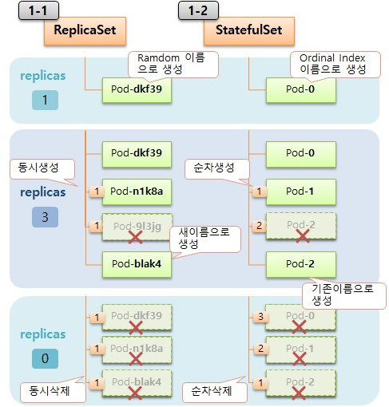
Understanding StatefulSets(9/10)
Understanding StatefulSet Guarantees :
  StatefulSets behave differently from ReplicaSets or ReplicationControllers. But this doesn’t end with the pods having a stable identity and storage. StatefulSets also have different guarantees regarding their pods.
  While regular, stateless pods are fungible, stateful pods aren’t(non-fungible). We’ve already seen how a stateful pod is always replaced with an identical pod (one having the same name and hostname, using the same persistent storage, and so on). This happens when Kubernetes sees that the old pod is no longer there (for example, when you delete the pod manually).
  But what if Kubernetes can’t be sure about the state of the pod? If it creates a replacement pod with the same identity, two instances of the app with the same identity might be running in the system. The two would also be bound to the same storage, so two processes with the same identity would be writing over the same files. With pods managed by a ReplicaSet, this isn’t a problem, because the apps are obviously made to work on the same files. Also, ReplicaSets create pods with a randomly generated identity, so there’s no way for two processes to run with the same identity.

Slide 17
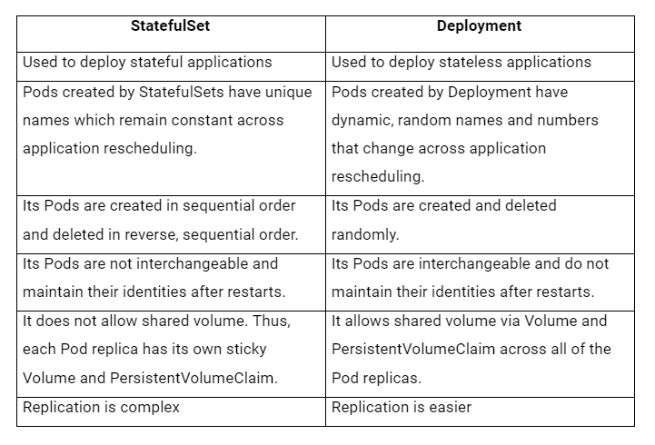
Understanding StatefulSets(10/10)
Understanding StatefulSet Guarantees :
  Kubernetes must thus take great care to ensure two stateful pod instances are never running with the same identity and are bound to the same PersistentVolumeClaim. A StatefulSet must guarantee at-most-one semantics for stateful pod instances.
  This means a StatefulSet must be absolutely certain that a pod is no longer running before it can create a replacement pod. This has a big effect on how node failures are handled.

Slide 18
Using a StatefulSet(1/21)
Creating the App and Container Image :
  To properly show StatefulSets in action, you’ll build your own little clustered data store. You’ll use the “kubia” app you’ve used before as your starting point. You’ll expand it so it allows you to store and retrieve a single data entry on each pod instance. The important parts of the source code of your data store are shown in the following listing.
  Whenever the app receives a POST request, it writes the data it receives in the body of the request to the file “/var/data/kubia.txt”. Upon a “GET”(request.method != ‘POST’) request, it returns the hostname and the stored data (contents of the file). This is the first version of your app. It’s not clustered yet, but it’s enough to get you started. You’ll expand the app later.
const http = require('http');
const os = require('os');
const fs = require('fs');
const dataFile = "/var/data/kubia.txt";
function fileExists(file) {
try {
fs.statSync(file);
return true;
} catch (e) {
return false;
}
}
var handler = function(request, response) {
if (request.method == 'POST') {
var file = fs.createWriteStream(dataFile);
file.on('open', function (fd) {
request.pipe(file);
console.log("New data has been received and stored.");
response.writeHead(200);
response.end("Data stored on pod " + os.hostname() + "\n");
});
} else {
var data = fileExists(dataFile) ? fs.readFileSync(dataFile, 'utf8') : "No data posted yet";
response.writeHead(200);
response.write("You've hit " + os.hostname() + "\n");
response.end("Data stored on this pod: " + data + "\n");
}
};
var www = http.createServer(handler);
www.listen(8080);
kubia-pet-image/app.js

Slide 19
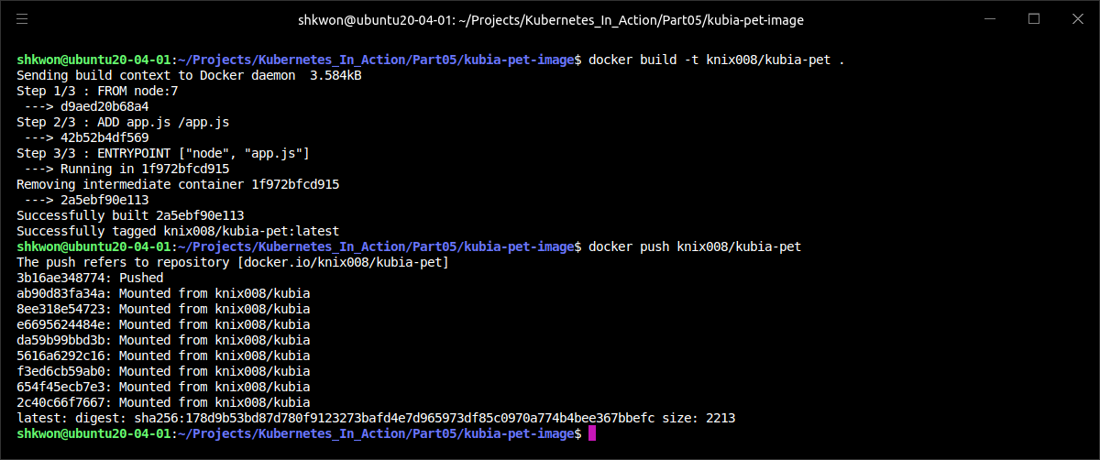
Using a StatefulSet(2/21)
Creating the App and Container Image :
  To create and push a Docker image into Docker Hub repository, you need to run the following commands :
$ docker build -t knix008/kubia-pet .
$ docker push knix008/kubia-pet

Slide 20
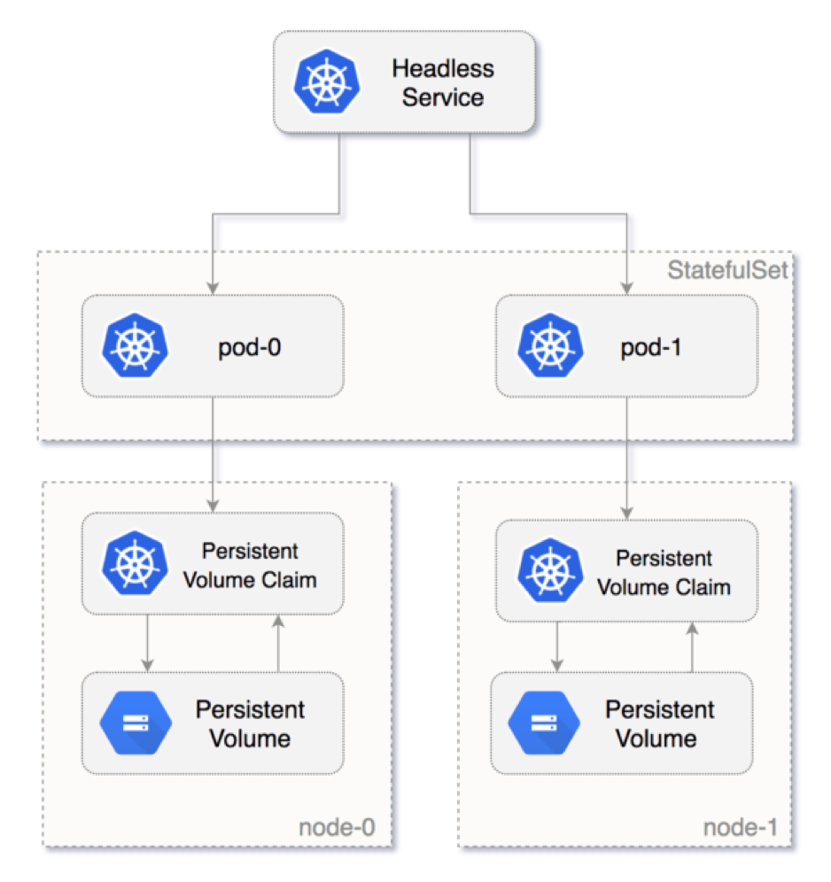
Using a StatefulSet(3/21)
Deploying the App Through a StatefulSet :
  To deploy your app, you’ll need to create two (or three) different types of objects :
    PersistentVolumes for storing your data files (you’ll need to create these only if the cluster doesn’t support dynamic provisioning of PersistentVolumes).
    A governing Service required by the StatefulSet.
    The StatefulSet itself.
  For each pod instance, the StatefulSet will create a PersistentVolumeClaim that will bind to a PersistentVolume. If your cluster supports dynamic provisioning, you don’t need to create any PersistentVolumes manually. If it doesn’t, you’ll need to create them.
  You’ll need three PersistentVolumes, because you’ll be scaling the StatefulSet up to three replicas. You must create more if you plan on scaling the StatefulSet up more than that.

Slide 21
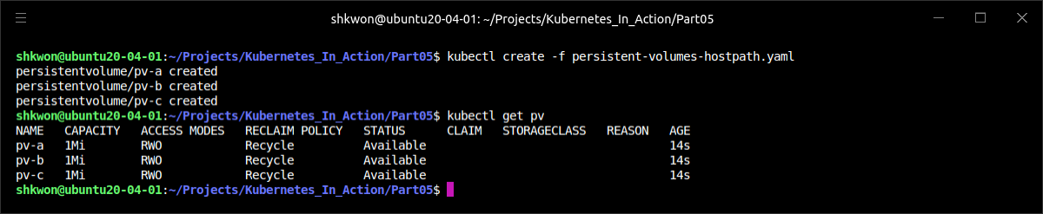
Using a StatefulSet(4/21)
Deploying the App Through a StatefulSet :
  If you’re using Minikube, deploy the PersistentVolumes defined in “persistent-volumes-hostpath.yaml” file.
  If you’re using Google Kubernetes Engine(GKE), you’ll first need to create the actual GCE Persistent Disks using the following commands :
  NOTE : Make sure to create the disks in the same zone that your nodes are running in.
  For Minikube, use the following command.
$ gcloud compute disks create --size=1GiB --zone=europe-west1-b pv-a
$ gcloud compute disks create --size=1GiB --zone=europe-west1-b pv-b
$ gcloud compute disks create --size=1GiB --zone=europe-west1-b pv-c
$ kubectl create -f persistent-volumes-hostpath.yaml

Slide 22
Using a StatefulSet(5/21)
Deploying the App Through a StatefulSet :
  The “persistent-volumes-hostpath.yaml” file, which is shown in the following listing :
  NOTE : Here we defined a List object and listing the resources as items of the object, which is same as multiple resources definition in one YAML file with “---” separator.
kind: List
apiVersion: v1
items:
- apiVersion: v1
kind: PersistentVolume
metadata:
name: pv-a
spec:
capacity:
storage: 1Mi
accessModes:
- ReadWriteOnce
persistentVolumeReclaimPolicy: Recycle
hostPath:
path: /tmp/pv-a
- apiVersion: v1
kind: PersistentVolume
metadata:
name: pv-b
spec:
capacity:
storage: 1Mi
accessModes:
- ReadWriteOnce
persistentVolumeReclaimPolicy: Recycle
hostPath:
path: /tmp/pv-b
- apiVersion: v1
kind: PersistentVolume
metadata:
name: pv-c
spec:
capacity:
storage: 1Mi
accessModes:
- ReadWriteOnce
persistentVolumeReclaimPolicy: Recycle
hostPath:
path: /tmp/pv-c
persistent-volumes-hostpath.yaml

Slide 23
Using a StatefulSet(6/21)
Deploying the App Through a StatefulSet :
  The previous manifest YAML file creates PersistentVolumes called “pv-a”, “pv-b”, and “pv-c”. They use “Hostpath” Persistent Disks as the underlying storage mechanism. If you’re running the cluster elsewhere, you must modify the PersistentVolume definition and use an appropriate volume type, such as NFS (Network File System), or similar.
  Before deploying a StatefulSet, you first need to create a headless Service, which will be used to provide the network identity for your stateful pods. The following listing shows the Service manifest.
  NOTE : You’re setting the “clusterIP” field to “None”, which makes this a “headless” Service. It will enable peer discovery between your pods (you’ll need this later). Once you create the Service, you can move on to creating the actual StatefulSet.
apiVersion: v1
kind: Service
metadata:
name: kubia
spec:
clusterIP: None
selector:
app: kubia
ports:
- name: http
port: 80
kubia-service-headless.yaml

Slide 24
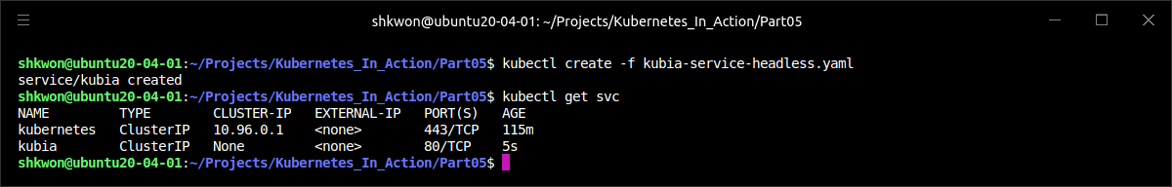
Using a StatefulSet(7/21)
Deploying the App Through a StatefulSet :
  To create the headless Service, use the following command :
$ kubectl create -f kubia-service-headless.yaml

Slide 25
Using a StatefulSet(8/21)
Deploying the App Through a StatefulSet :
  Now you can finally create the StatefulSet. The following listing shows the manifest.
  The StatefulSet manifest isn’t that different from ReplicaSet or Deployment manifests you’ve created so far. What’s new is the volumeClaimTemplates list. In it, you’re defining one volume claim template called “data”, which will be used to create a PersistentVolumeClaim for each pod. A pod references a claim by including a persistentVolumeClaim volume in the manifest.
apiVersion: apps/v1
kind: StatefulSet
metadata:
name: kubia
spec:
serviceName: kubia
replicas: 2
selector:
matchLabels:
app: kubia # has to match .spec.template.metadata.labels
template:
metadata:
labels:
app: kubia
spec:
containers:
- name: kubia
image: knix008/kubia-pet
ports:
- name: http
containerPort: 8080
volumeMounts:
- name: data
mountPath: /var/data
volumeClaimTemplates:
- metadata:
name: data
spec:
resources:
requests:
storage: 1Mi
accessModes:
- ReadWriteOnce
kubia-statefulset.yaml

Slide 26
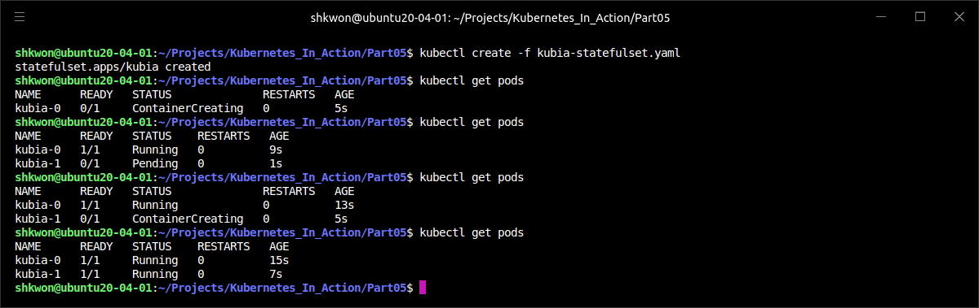
Using a StatefulSet(9/21)
Deploying the App Through a StatefulSet :
  In the previous pod template, you’ll find no such volume. The StatefulSet adds it to the pod specification automatically and configures the volume to be bound to the claim the StatefulSet created for the specific pod.
  You’ll create the StatefulSet now :
$ kubectl create -f kubia-statefulset.yaml
$ kubectl get pods

Slide 27
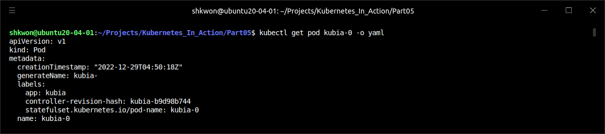
Using a StatefulSet(10/21)
Deploying the App Through a StatefulSet :
  A ReplicationController or a ReplicaSet creates all the pod instances at the same time. Your StatefulSet is configured to create two replicas, but it created a single pod. The second pod will be created only after the first one is up and ready.
  StatefulSets behave this way because certain clustered stateful apps are sensitive to race conditions if two or more cluster members come up at the same time, so it’s safer to bring each member up fully before continuing to bring up the rest.
  See how the StatefulSet has constructed the pod from the pod template and the PersistentVolumeClaim template with the following command.
$ kubectl get pod kubia-0 -o yaml

Slide 28
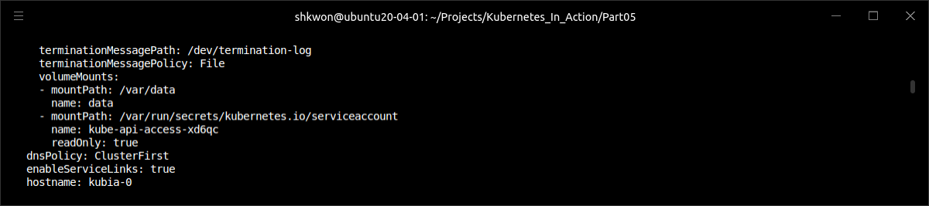
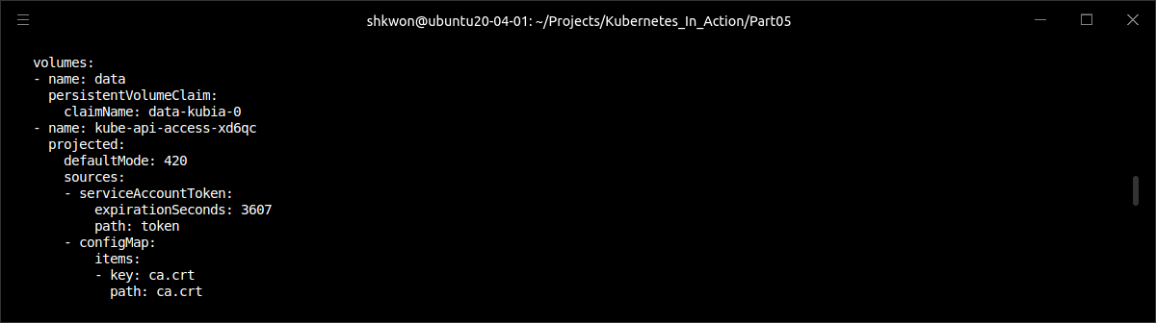
Using a StatefulSet(11/21)
Deploying the App Through a StatefulSet :
  The PersistentVolumeClaim template was used to create the PersistentVolumeClaim and the volume inside the pod, which refers to the created PersistentVolumeClaim.

Slide 29
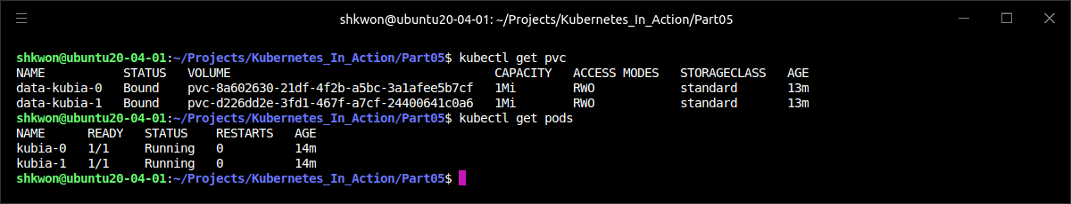
Using a StatefulSet(12/21)
Deploying the App Through a StatefulSet :
  Now list the generated PersistentVolumeClaims to confirm they were created with the following command :
  NOTE : The names of the generated PersistentVolumeClaims are composed of the name defined in the volumeClaimTemplate and the name of each pod. You can examine the claims’ YAML to see that they match the template.
$ kubectl get pvc

Slide 30
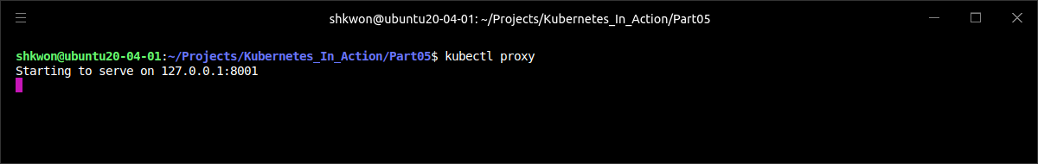
Using a StatefulSet(13/21)
Playing with Your Pods :
  You can’t communicate with your pods through the Service you created because it’s headless. You’ll need to connect to individual pods directly (or create a regular Service, but that wouldn’t allow you to talk to a specific pod).
  You’ve already seen ways to connect to a pod directly: by piggybacking on another pod and running “curl” inside it, by using port-forwarding, and so on. This time, you’ll try another option. You’ll use the API server as a proxy to the pods.
  One useful feature of the API server is the ability to proxy connections directly to individual pods. If you want to perform requests against your “kubia-0” pod, you hit the following URL :
  Because the API server is secured, sending requests to pods through the API server is cumbersome (among other things, you need to pass the authorization token in each request). Luckily, you already learned how to use kubectl proxy to talk to the API server without having to deal with authentication and SSL certificates.
  Run the proxy again :
<apiServerHost>:<port>/api/v1/namespaces/default/pods/kubia-0/proxy/<path>
$ kubectl proxy

Slide 31
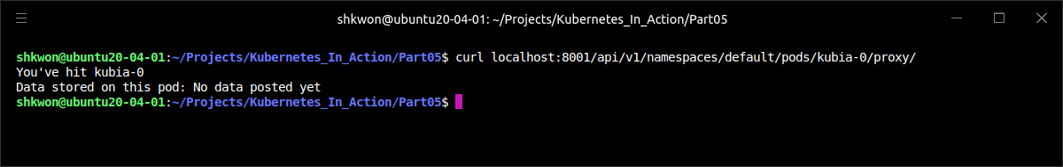
Using a StatefulSet(14/21)
Playing with Your Pods :
  Now, because you’ll be talking to the API server through the “kubectl proxy”, you’ll use “localhost:8001” rather than the actual API server host and port. Open another terminal first, then you’ll send a request to the “kubia-0” pod like this:
  The response shows that the request was indeed received and handled by the app running in your pod “kubia-0”.
  NOTE : If you receive an empty response, make sure you haven’t left out that last slash character at the end of the URL (or make sure “curl” follows redirects by using its “-L” option).
$ curl localhost:8001/api/v1/namespaces/default/pods/kubia-0/proxy/

Slide 32
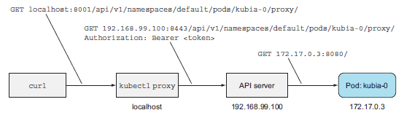
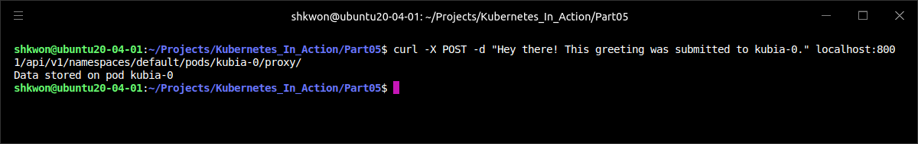
Using a StatefulSet(15/21)
Playing with Your Pods :
  Because you’re communicating with the pod through “the API server”, which you’re connecting to through the “kubectl proxy”, the request went through two different proxies (the first was the “kubectl proxy” and the other was “the API server”, which proxied the request to the pod). For a clearer picture, examine the following figure.
  The request you sent to the pod was a GET request, but you can also send POST requests through the API server. This is done by sending a POST request to the same proxy URL as the one you sent the GET request to. When your app receives a POST request, it stores whatever’s in the request body into a local file. Send a POST request to the “kubia-0” pod :
$ curl -X POST -d "Hey there! This greeting was submitted to kubia-0." localhost:8001/api/v1/namespaces/default/pods/kubia-0/proxy/

Slide 33
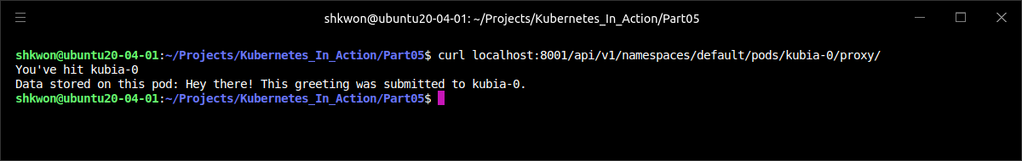

Using a StatefulSet(16/21)
Playing with Your Pods :
  The data you sent should now be stored in that pod. Let’s see if it returns the stored data when you perform a GET request again :
  Now let’s see what the other cluster node (the “kubia-1” pod) says :
$ curl localhost:8001/api/v1/namespaces/default/pods/kubia-0/proxy/
$ curl localhost:8001/api/v1/namespaces/default/pods/kubia-1/proxy/

Slide 34
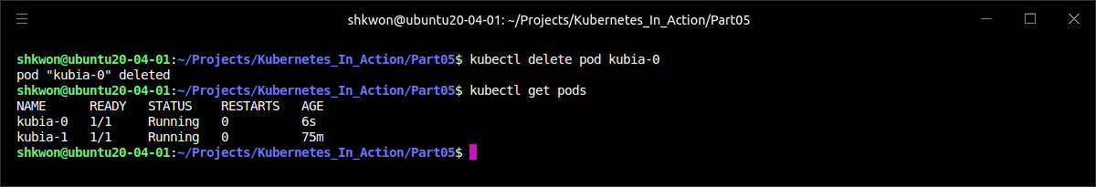
Using a StatefulSet(17/21)
Playing with Your Pods :
  You’re going to delete the “kubia-0” pod and wait for it to be rescheduled. Then you’ll see if it’s still serving the same data as before :
  If you list the pods, you’ll see that the pod is terminating(or running already but the “AGE” is different. As soon as it terminates successfully, a new pod with the same name is created by the StatefulSet.
  NOTE : Let me remind you again that this new pod may be scheduled to any node in the cluster, not necessarily the same node that the old pod was scheduled to.
$ kubectl delete pod kubia-0

Slide 35
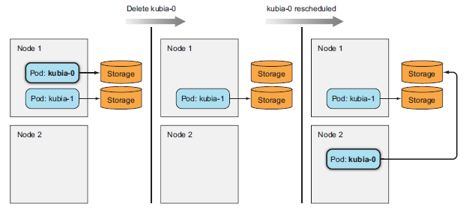
Using a StatefulSet(18/21)
Playing with Your Pods :
  The old pod’s whole identity (the name, hostname, and the storage) is effectively moved to the new node (as shown in the following figure). If you’re using Minikube, you can’t see this because Minikube only runs a single node, but in a multi-node cluster, you may see the pod scheduled to a different node than before.

Slide 36
Using a StatefulSet(19/21)
Playing with Your Pods :
  With the new pod now running, let’s check to see if it has the exact same identity as in its previous incarnation. The pod’s name is the same, but what about the hostname and persistent data? You can ask the pod itself to confirm :
  NOTE : The pod’s response shows that both the hostname and the data are the same as before, confirming that a StatefulSet always replaces a deleted pod with what’s effectively the exact same pod.
$ curl localhost:8001/api/v1/namespaces/default/pods/kubia-0/proxy/

Slide 37
Using a StatefulSet(20/21)
Playing with Your Pods :
  Scaling down a StatefulSet and scaling it back up after an extended time period should be no different than deleting a pod and having the StatefulSet recreate it immediately. Remember that scaling down a StatefulSet only deletes the pods, but leaves the PersistentVolumeClaims untouched.
  The key thing to remember is that scaling down (and up) is performed gradually—similar to how individual pods are created when the StatefulSet is created initially. When scaling down by more than one instance, the pod with the highest ordinal number is deleted first. Only after the pod terminates completely is the pod with the second highest ordinal number deleted.
  Before you move on, you’re going to add a proper, non-headless Service in front of your pods, because clients usually connect to the pods through a Service rather than connecting directly.
  NOTE : Because this isn’t an externally exposed Service (it’s a regular ClusterIP Service, not a NodePort or a LoadBalancer-type Service), you can only access it from inside the cluster. You’ll need a pod to access it from, right? Not necessarily.
apiVersion: v1
kind: Service
metadata:
name: kubia-public
spec:
selector:
app: kubia
ports:
- port: 80
targetPort: 8080
kubia-service-public.yaml

Slide 38
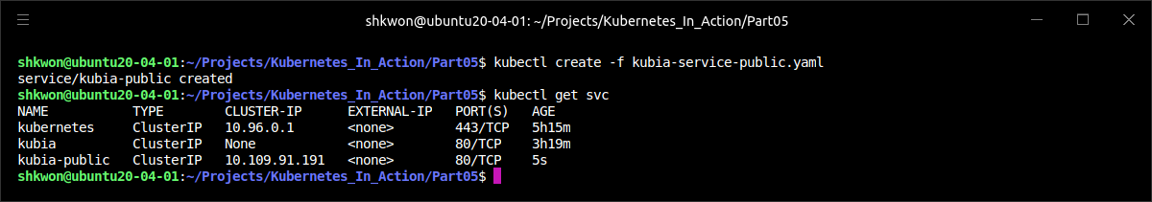
NOTE : Creating Non-Headless Service
Non-Headless Service for StatefulSet :
  You need to create the Non-Headless Service for the rest of the example. Run the following command. :
$ kubectl create -f kubia-service-public.yaml

Slide 39
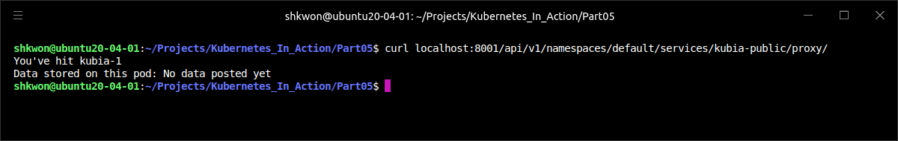
Using a StatefulSet(21/21)
Playing with Your Pods :
  Instead of using a piggyback pod to access the service from inside the cluster, you can use the same proxy feature provided by the API server to access the service the way you’ve accessed individual pods.
  The URI path for proxy-ing requests to Services is formed like this :
  Therefore, you can run curl on your local machine and access the service through the “kubectl proxy” command like this (you ran “kubectl proxy” command earlier and it should still be running):
  Likewise, clients (inside the cluster) can use the “kubia-public” service for storing to and reading data from your clustered data store. Of course, each request lands on a random cluster node, so you’ll get the data from a random node each time.
/api/v1/namespaces/<namespace>/services/<service name>/proxy/<path>
$ curl localhost:8001/api/v1/namespaces/default/services/kubia-public/proxy/

Slide 40
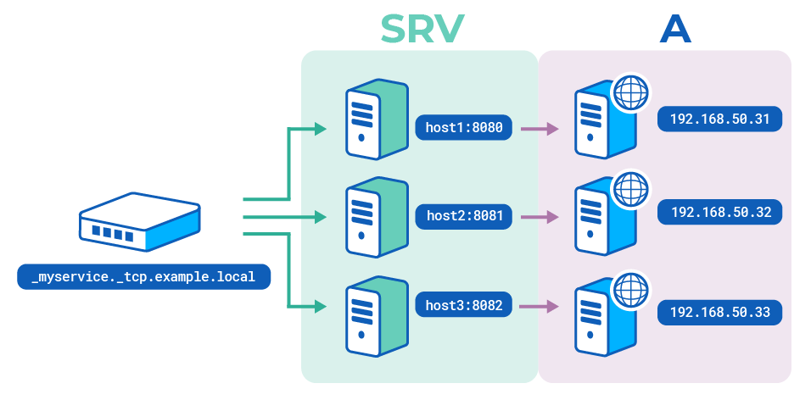
Discovering Peers in a StatefulSet(1/12)
SRV(SERVICE) Record :
  An important requirement of clustered apps is peer discovery—the ability to find other members of the cluster. Each member of a StatefulSet needs to easily find all the other members. Sure, it could do that by talking to the API server, but one of Kubernetes’ aims is to expose features that help keep applications completely Kubernetes-agnostic. Having apps talk to the Kubernetes API is therefore undesirable.
  Depending on how much you know about DNS, you probably understand what an A, CNAME, or MX record is used for. Other lesser-known types of DNS records also exist. One of them is the SRV record.

Slide 41
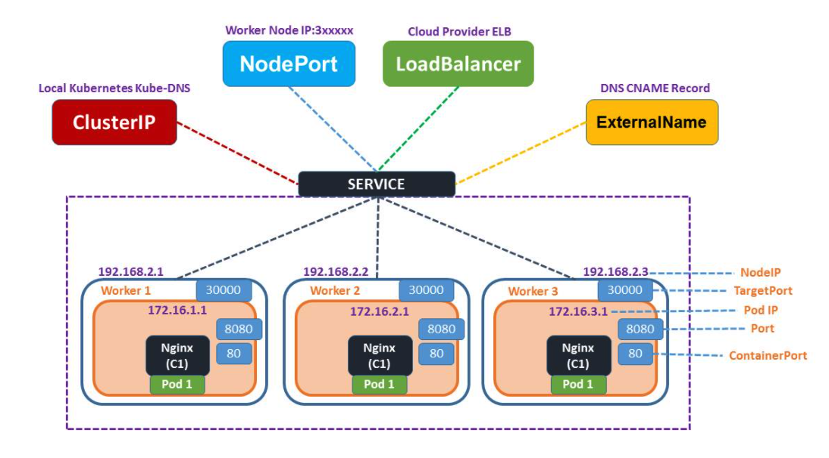
Discovering Peers in a StatefulSet(2/12)
Introducing SRV Records :
  SRV records are used to point to hostnames and ports of servers providing a specific service. Kubernetes creates SRV records to point to the hostnames of the pods backing a headless service.
  You’re going to list the SRV records for your stateful pods by running the “dig” DNS lookup tool inside a new temporary pod. This is the command you’ll use :
  The command runs a one-off pod (“--restart=Never”) called “srvlookup”, which is attached to the console (“-it”) and is deleted as soon as it terminates (“--rm”). The pod runs a single container from the “tutum/dnsutils” image and runs the following command :
$ kubectl run -it srvlookup --image=tutum/dnsutils --rm --restart=Never -- dig SRV kubia.default.svc.cluster.local
$ dig SRV kubia.default.svc.cluster.local

Slide 42
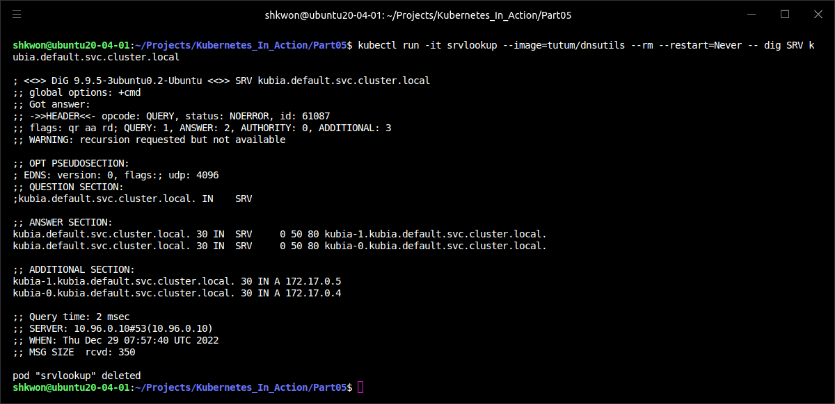
Discovering Peers in a StatefulSet(3/12)
Introducing SRV Records :
  The following listing shows what the previous command prints out :

Slide 43
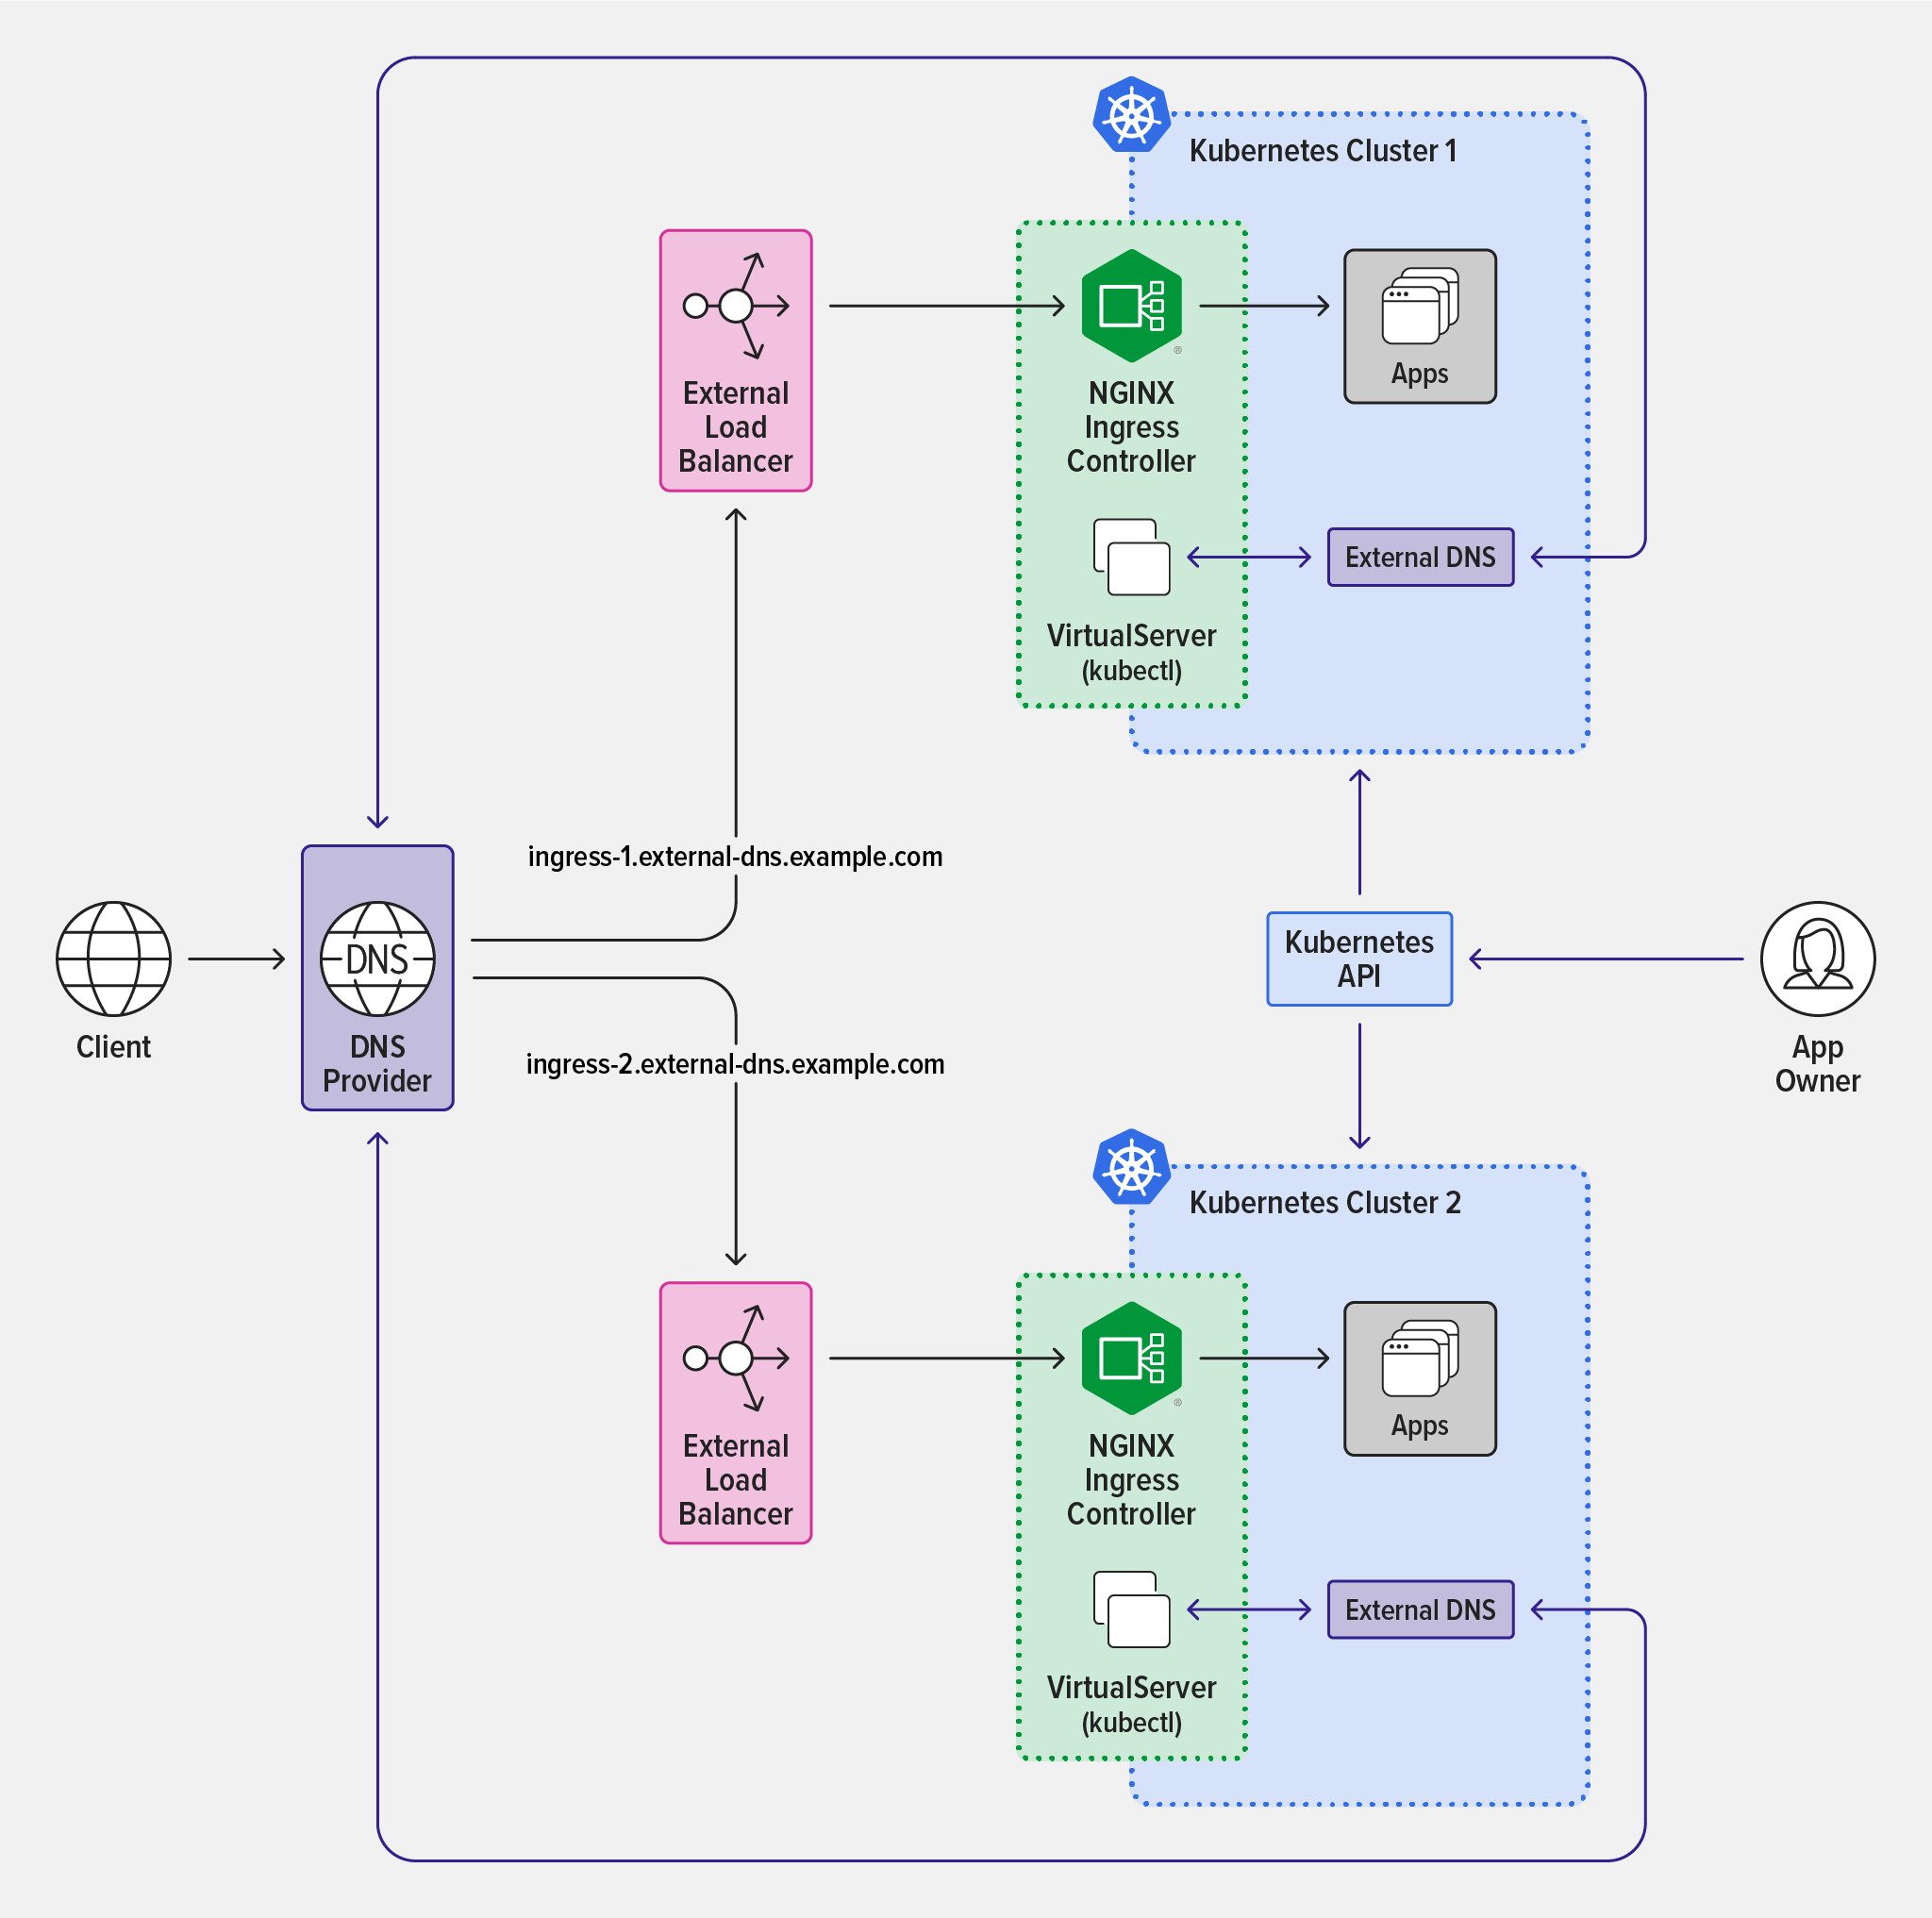
Discovering Peers in a StatefulSet(4/12)
Introducing SRV Records :
  The “ANSWER SECTION” shows two “SRV records” pointing to the two pods backing your headless service. Each pod also gets its own “A record”, as shown in “ADDITIONAL SECTION”.
  For a pod to get a list of all the other pods of a StatefulSet, all you need to do is perform an “SRV DNS lookup”. In “Node.js”, for example, the lookup is performed like this :
  You’ll use this command in your app to enable each pod to discover its peers.
  NOTE : The order of the returned SRV records is random, because they all have the same priority. Don’t expect to always see “kubia-0” listed before “kubia-1”.
dns.resolveSrv("kubia.default.svc.cluster.local", callBackFunction);

Slide 44
Discovering Peers in a StatefulSet(5/12)
Implementing Peer Discovery Through DNS :
  Each data store node runs completely independently of all the others—no communication exists between them. You’ll get them talking to each other next.
  Data posted by clients connecting to your data store cluster through the “kubia-public” Service lands on a random cluster node. The cluster can store multiple data entries, but clients currently have no good way to see all those entries. Because services forward requests to pods randomly, a client would need to perform many requests until it hit all the pods if it wanted to get the data from all the pods.
  You can improve this by having the node respond with data from all the cluster nodes. To do this, the node needs to find all its peers. You’re going to use what you learned about StatefulSets and SRV records to do this.
const http = require('http');
const os = require('os');
const fs = require('fs');
const dns = require('dns');
const dataFile = "/var/data/kubia.txt";
const serviceName = "kubia.default.svc.cluster.local";
const port = 8080;
function fileExists(file) {
try {
fs.statSync(file);
return true;
} catch (e) {
return false;
}
}
function httpGet(reqOptions, callback) {
return http.get(reqOptions, function(response) {
var body = '';
response.on('data', function(d) { body += d; });
response.on('end', function() { callback(body); });
}).on('error', function(e) {
callback("Error: " + e.message);
});
}
…
kubia-pet-peers-image/app.js

Slide 45
Discovering Peers in a StatefulSet(6/12)
Implementing Peer Discovery Through DNS :
  As you can see from the following code, “dns.resolveSrv()” is used to get the peer list and the response values are used to find other peers. Then it send “HTTP GET request” to each peers :
…
var handler = function(request, response) {
if (request.method == 'POST') {
var file = fs.createWriteStream(dataFile);
file.on('open', function (fd) {
request.pipe(file);
response.writeHead(200);
response.end("Data stored on pod " + os.hostname() + "\n");
});
} else {
response.writeHead(200);
if (request.url == '/data') {
var data = fileExists(dataFile) ? fs.readFileSync(dataFile, 'utf8') : "No data posted yet";
response.end(data);
} else {
response.write("You've hit " + os.hostname() + "\n");
response.write("Data stored in the cluster:\n");
dns.resolveSrv(serviceName, function (err, addresses) {
if (err) {
response.end("Could not look up DNS SRV records: " + err);
return;
}
var numResponses = 0;
if (addresses.length == 0) {
response.end("No peers discovered.");
} else {
addresses.forEach(function (item) {
var requestOptions = {
host: item.name,
port: port,
path: '/data'
};
httpGet(requestOptions, function (returnedData) {
numResponses++;
response.write("- " + item.name + ": " + returnedData + "\n");
if (numResponses == addresses.length) {
response.end();
}
});
});
}
});
}
}
};
var www = http.createServer(handler);
www.listen(port);
kubia-pet-peers-image/app.js

Slide 46
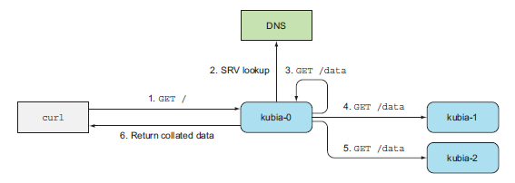
Discovering Peers in a StatefulSet(7/12)
Implementing Peer Discovery Through DNS :
  The following figure shows what happens when a GET request is received by your app. The server that receives the request first performs a lookup of SRV records for the headless kubia service and then sends a GET request to each of the pods backing the service (even to itself, which obviously isn’t necessary, but I wanted to keep the code as simple as possible). It then returns a list of all the nodes along with the data stored on each of them.
  The container image containing this new version of the app is available at “knix008/kubia-pet-peers”.

Slide 47
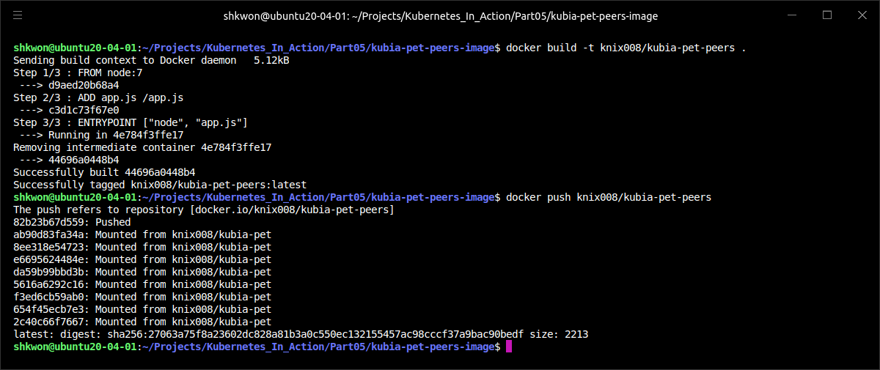
NOTE : Build Docker Image
Docker Image Build for The Example :
  You need to build the docker image and push it into the Docker Hub repository before you run the example. Use the following commands :
$ docker build -t knix008/kubia-pet-peers .
$ docker push knix008/kubia-pet-peers

Slide 48
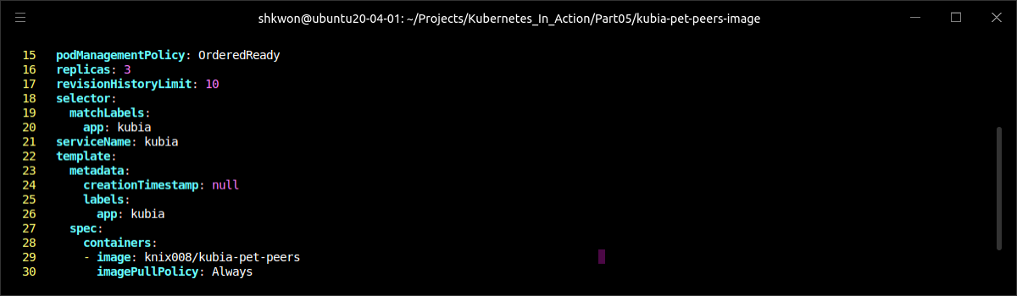
Discovering Peers in a StatefulSet(8/12)
Updating a StatefulSet :
  Your StatefulSet is already running, so let’s see how to update its pod template so the pods use the new image. You’ll also set the replica count to 3 at the same time. To update the StatefulSet, use the “kubectl edit” command (the “patch” command would be another option) :
  This opens the StatefulSet definition in your default editor. In the definition, change “spec.replicas” to 3 and modify the “spec.template.spec.containers.image” attribute so it points to the new image (“knix008/kubia-pet-peers” instead of “luksa/kubia-pet”).
$ kubectl edit statefulset kubia

Slide 49
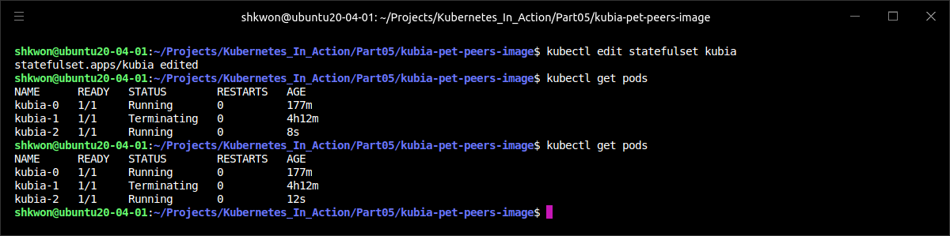
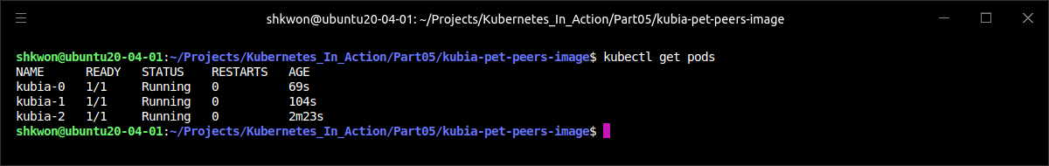
Discovering Peers in a StatefulSet(9/12)
Updating a StatefulSet :
  Save the file and exit the editor to update the StatefulSet. Two replicas were running previously, so you should now see an additional replica called “kubia-2” starting.

Slide 50
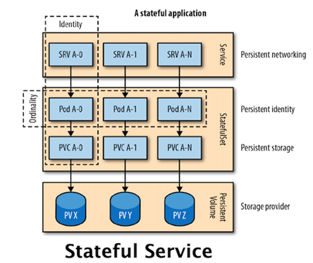
Discovering Peers in a StatefulSet(10/12)
Updating a StatefulSet :
  The new pod instance is running the new image. But what about the existing two replicas? Judging from their age in the previous screenshot, they seem to have been updated.
  NOTE : Starting from Kubernetes version 1.7, StatefulSets support rolling updates the same way Deployments and DaemonSets do. See the StatefulSet’s “spec.updateStrategy” field documentation using kubectl explain for more information. As you can see from the previous screenshot, we used the rolling updates of the StatefulSets.

Slide 51
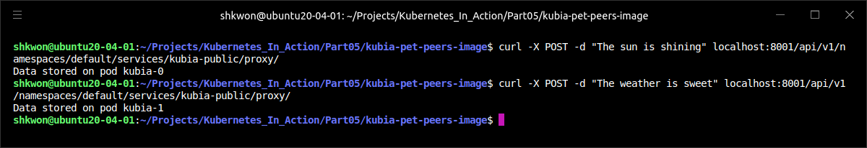
Discovering Peers in a StatefulSet(11/12)
Trying out Your Clustered Data Store :
  Once the two pods are up, you can see if your shiny new Stone Age data store works as expected. Post a few requests to the cluster, as shown in the following listing.
$ curl -X POST -d "The sun is shining" localhost:8001/api/v1/namespaces/default/services/kubia-public/proxy/
$ curl -X POST -d "The weather is sweet" localhost:8001/api/v1/namespaces/default/services/kubia-public/proxy/

Slide 52
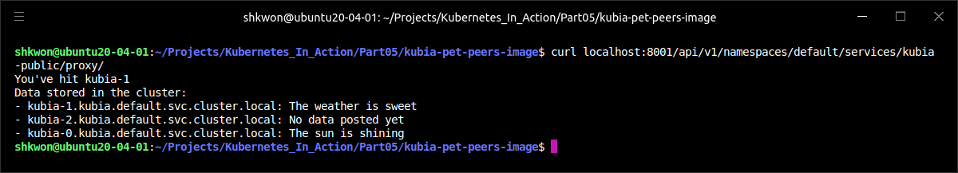
Discovering Peers in a StatefulSet(12/12)
Trying out Your Clustered Data Store :
  Now, read the stored data, as shown in the following listing.
  When a client request reaches one of your cluster nodes, it discovers all its peers, gathers data from them, and sends all the data back to the client(“knix008/kubia-pet-peers” Docker Image). Even if you scale the StatefulSet up or down, the pod servicing the client’s request can always find all the peers running at that time.
  In this example, you found that instances of a replicated stateful app can discover their peers and handle horizontal scaling with ease.
  NOTICE : Here you are still running “$ kubectl proxy” command in another terminal.
$ curl localhost:8001/api/v1/namespaces/default/services/kubia-public/proxy/

Slide 53
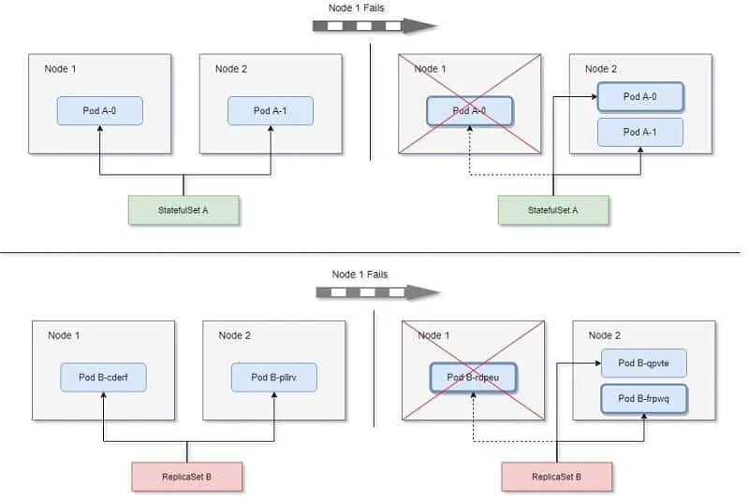
Understanding How StatefulSets Deal with Node Failure(1/)
Handling Node Failure in StatefulSets :
  Kubernetes must be absolutely sure that a stateful pod is no longer running before creating its replacement. When a node fails abruptly, Kubernetes can’t know the state of the node or its pods. It can’t know whether the pods are no longer running, or if they still are and are possibly even still reachable, and it’s only the Kubelet that has stopped reporting the node’s state to the master.
  Because a StatefulSet guarantees that there will never be two pods running with the same identity and storage, when a node appears to have failed, the StatefulSet cannot and should not create a replacement pod until it knows for certain that the pod is no longer running.
  It can only know that when the cluster administrator tells it so. To do that, the admin needs to either delete the pod or delete the whole node (doing so then deletes all the pods scheduled to the node).

Slide 54
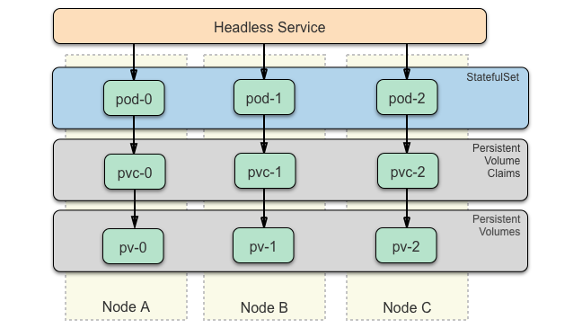
Understanding How StatefulSets Deal with Node Failure(2/)
Handling Node Failure in StatefulSets :
  If the node were down and came back online and report its and its pod statuses again, the pod would again be marked as “Running”. But if the pod’s status remains unknown for more than a few minutes (this time is configurable), the pod is automatically evicted from the node. This is done by the master (the Kubernetes control plane). It evicts the pod by deleting the pod resource.
  When the Kubelet sees that the pod has been marked for deletion, it starts terminating the pod. The Kubelet can no longer reach the master (because the node was disconnected from the network), which means the pod will keep running in the disconnected node.

Slide 55
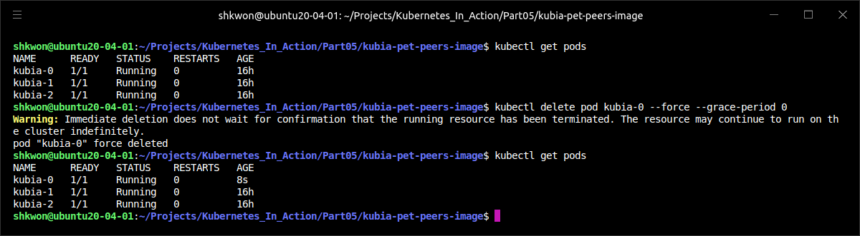
Understanding How StatefulSets Deal with Node Failure(3/)
Deleting Pods Manually :
  If you know the node isn’t coming back, but you need all three pods running to handle clients properly. You need to get the pod rescheduled to a healthy node. In this case, you need to delete the node or the pod manually.
  The pod was marked for deletion even before you deleted it. That’s because the control plane itself already deleted it (in order to evict it from the node). Sometime, you’ll see that the pod’s status is “Terminating”. The pod was already marked for deletion earlier and will be removed as soon as the Kubelet on its node notifies the API server that the pod’s containers have terminated. If the node’s network is down, this will never happen.
  The only thing you can do is tell the API server to delete the pod without waiting for the Kubelet to confirm that the pod is no longer running. You do that like this :
$ kubectl delete pod kubia-0 --force --grace-period 0

Slide 56
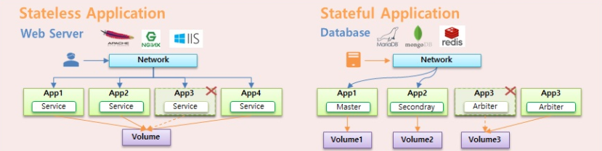
Understanding How StatefulSets Deal with Node Failure(4/)
Deleting Pods Manually :
  As you can see from the previous screenshot, you deleted the pod a moment ago and kubectl said it had deleted it. Why is the same pod still there? When the pod was deleted, the API server detected the status and create another pods in the available nodes(In Minikube, there is only one node).
  NOTE : You need to use both the “--force” and “--grace-period 0” options. The warning displayed by kubectl notifies you of what you did. If you list the pods again, you’ll finally see a new “kubia-0” pod created(see the “AGE” column).
  WARNING : Don’t delete stateful pods forcibly unless you know the node is no longer running or is unreachable (and will remain so forever).

Slide 57
Advanced Topics

Slide 58
Kubernetes Internals
Understanding Kubernetes Internals

Slide 59
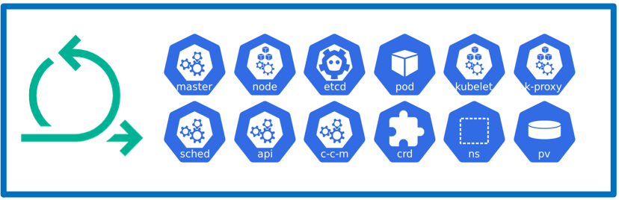
Understanding the Architecture(1/39)
The Components :
  Before you look at how Kubernetes does what it does, let’s take a closer look at the components that make up a Kubernetes cluster. As you saw that a Kubernetes cluster is split into two parts :
    The Kubernetes Control Plane
    The (worker) nodes
  The Control Plane is what controls and makes the whole cluster function. To refresh your memory, the components that make up the Control Plane are :
    The etcd distributed persistent storage
    The API server
    The Scheduler
    The Controller Manager
  These components store and manage the state of the cluster, but they aren’t what runs the application containers.
  The task of running your containers is up to the components running on each worker node :
    The Kubelet
    The Kubernetes Service Proxy (kube-proxy)
    The Container Runtime (Docker, rkt, or others)

Slide 60
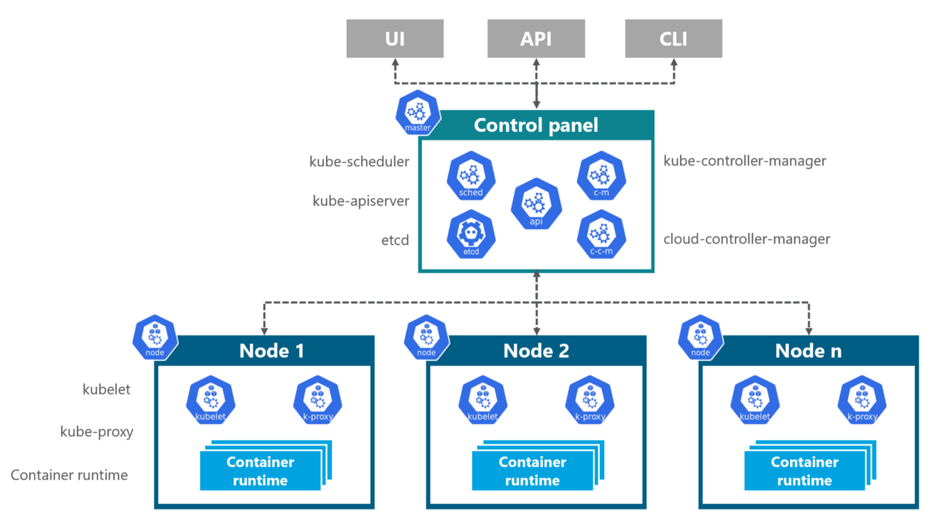
Understanding the Architecture(2/39)
The Components :
  Beside the Control Plane components and the components running on the nodes, a few add-on components are required for the cluster. This includes :
    The Kubernetes DNS server
    The Dashboard
    An Ingress controller
    Heapster
    The Container Network Interface network plugin

Slide 61
NOTE : The Big Picture
The Kubernetes Cluster Architecture :

Slide 62
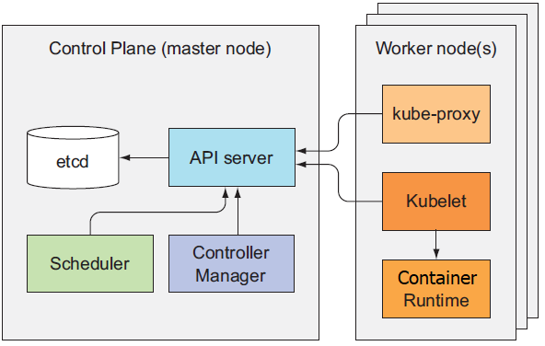
Understanding the Architecture(3/39)
The Distributed Nature of Kubernetes Components :
  The previously mentioned components all run as individual processes. The components and their inter-dependencies are shown in the following figure.
  To get all the features Kubernetes provides, all these components need to be running. But several can also perform useful work individually without the other components.

Slide 63
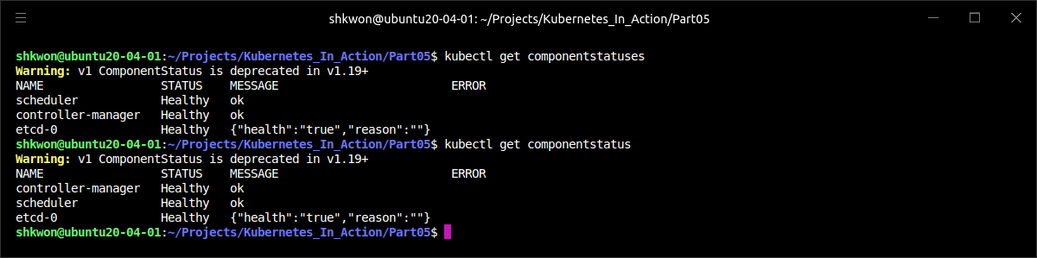
Understanding the Architecture(4/39)
The Distributed Nature of Kubernetes Components :
  To check the status of the Control Plane components, you can use an API resource exposed by the API server called “ComponentStatus”, which shows the health status of each Control Plane component. You can list the components and their statuses with kubectl command like the following.
$ kubectl get componentstatuses

Slide 64
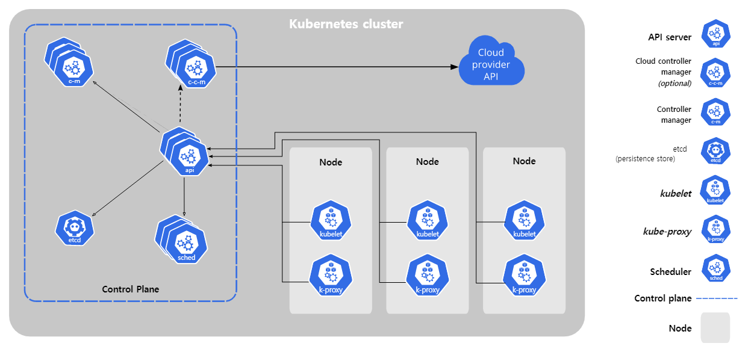
Understanding the Architecture(5/39)
The Distributed Nature of Kubernetes Components :
  Kubernetes system components communicate only with the API server. They don’t talk to each other directly. The API server is the only component that communicates with etcd. None of the other components communicate with etcd directly, but instead modify the cluster state by talking to the API server.
  Connections between the API server and the other components are almost always initiated by the components. But the API server does connect to the Kubelet when you use kubectl to fetch logs, use kubectl attach to connect to a running container, or use the kubectl port-forward command.
  NOTE : The “kubectl attach” command is similar to “kubectl exec”, but it attaches to the main process running in the container instead of running an additional one.

Slide 65
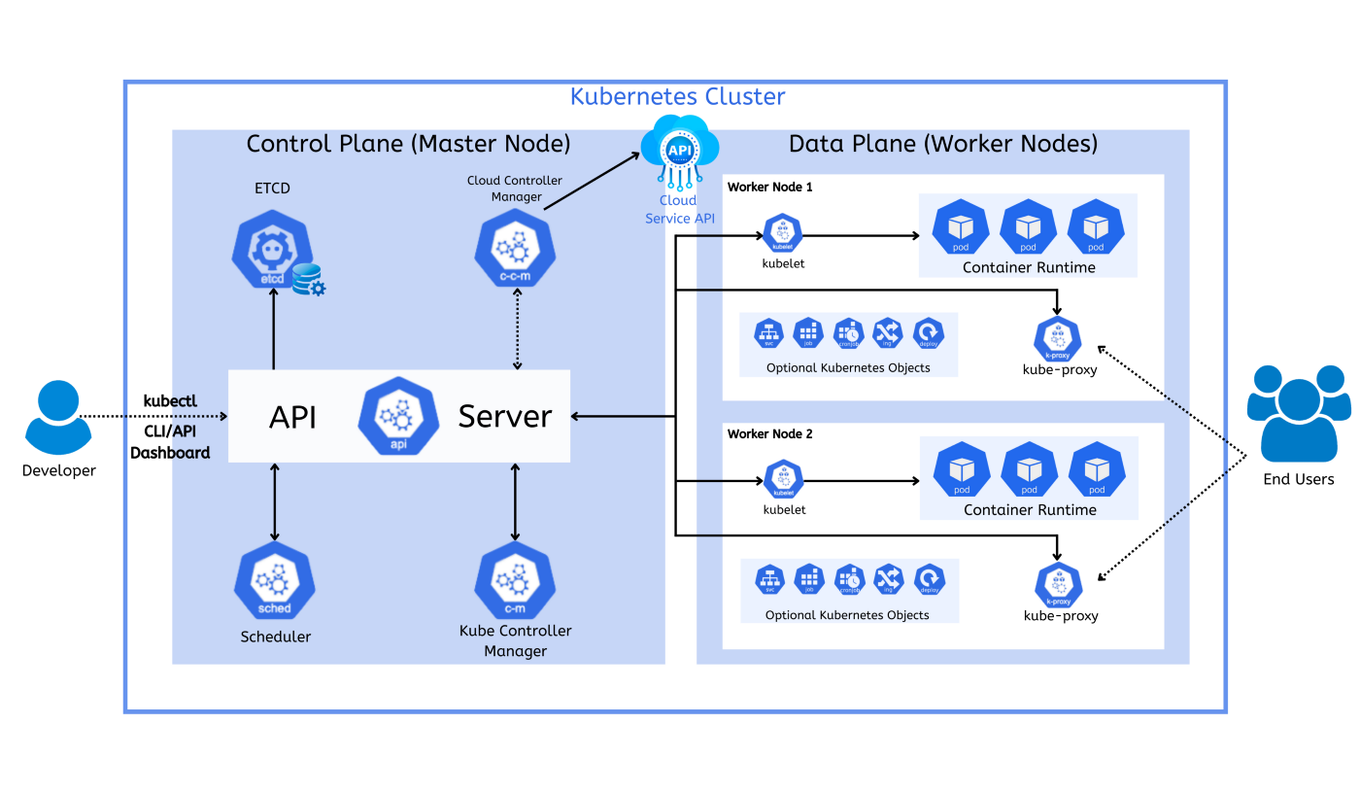
Understanding the Architecture(6/39)
The Distributed Nature of Kubernetes Components :
  Although the components on the worker nodes all need to run on the same node, the components of the Control Plane can easily be split across multiple servers. There can be more than one instance of each Control Plane component running to ensure high availability(HA). While multiple instances of “etcd” and API server can be active at the same time and do perform their jobs in parallel, only a single instance of the Scheduler and the Controller Manager may be active at a given time—with the others in standby mode.

Slide 66
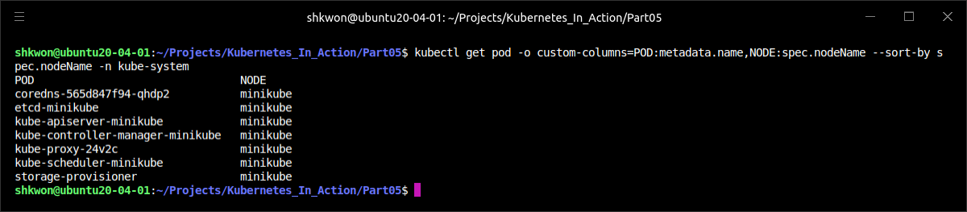
Understanding the Architecture(7/39)
The Distributed Nature of Kubernetes Components :
  The Control Plane components, as well as kube-proxy, can either be deployed on the system directly or they can run as pods (as shown in the following screenshot).
  The Kubelet is the only component that always runs as a regular system component, and it’s the Kubelet that then runs all the other components as pods. To run the Control Plane components as pods, the Kubelet is also deployed on the master.
  As you can see from the above screenshot, all the Control Plane components are running as pods on the master node(here it is “minikube”). There is just one master node(and also worker node, minikube) and the node runs the “kube-proxy”.
  TIP : As shown in the listing, you can tell kubectl to display custom columns with the “-o custom-columns” option and sort the resource list with “--sort-by”.
$ kubectl get pod -o custom-columns=POD:metadata.name,NODE:spec.nodeName --sort-by spec.nodeName -n kube-system

Slide 67
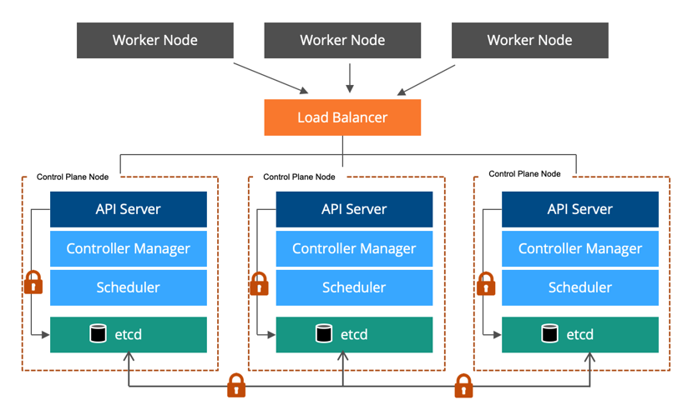
Understanding the Architecture(8/39)
The Distributed Nature of Kubernetes Components :
  All the objects you’ve created before—Pods, ReplicationControllers, Services, Secrets, and so on—need to be stored somewhere in a persistent manner so their manifests survive API server restarts and failures. For this, Kubernetes uses etcd, which is a fast, distributed, and consistent key-value store. Because it’s distributed, you can run more than one etcd instance to provide both high availability and better performance.
  The only component that talks to etcd directly is the Kubernetes API server. All other components read and write data to etcd indirectly through the API server. This brings a few benefits, among them a more robust optimistic locking system as well as validation; and, by abstracting away the actual storage mechanism from all the other components, it’s much simpler to replace it in the future. It’s worth emphasizing that etcd is the only place Kubernetes stores cluster state and metadata.

Slide 68
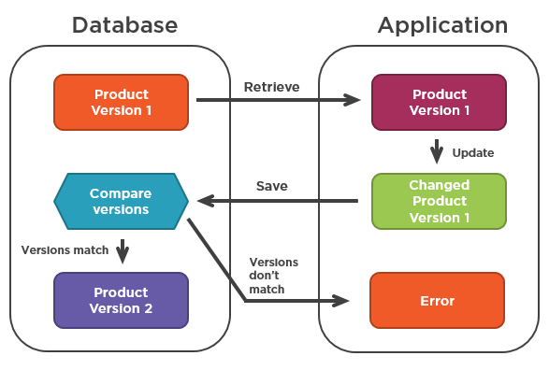
Understanding the Architecture(9/39)
The Distributed Nature of Kubernetes Components :
  Optimistic concurrency control (sometimes referred to as optimistic locking) is a method where instead of locking a piece of data and preventing it from being read or updated while the lock is in place, the piece of data includes a version number.
  Every time the data is updated, the version number increases. When updating the data, the version number is checked to see if it has increased between the time the client read the data and the time it submits the update. If this happens, the update is rejected and the client must re-read the new data and try to update it again. The result is that when two clients try to update the same data entry, only the first one succeeds.
  All Kubernetes resources include a “metadata.resourceVersion” field, which clients need to pass back to the API server when updating an object. If the version doesn’t match the one stored in etcd, the API server rejects the update.

Slide 69
Understanding the Architecture(10/39)
The Distributed Nature of Kubernetes Components :
  Kubernetes can use either etcd version 2 or version 3, but version 3 is now recommended because of improved performance. etcd v2 stores keys in a hierarchical key space, which makes key-value pairs similar to files in a file system. Each key in etcd is either a directory, which contains other keys, or is a regular key with a corresponding value. etcd v3 doesn’t support directories, but because the key format remains the same (keys can include slashes), you can still think of them as being grouped into directories. Kubernetes stores all its data in “etcd” under “/registry”. To see the contents of the “/registry”, you need to use “etcdctl” command.
  NOTE : If you want to use “etcdctl” command, you need install it with “$ sudo apt install etcd-client” command.
  NOTE : If you’re using v3 of the etcd API, you can’t use the “ls” command to see the contents of a directory. Instead, you can list all keys that start with a given prefix with “$ etcdctl get /registry --prefix=true”.
  For more information, see the following link - https://kubernetes.io/docs/tasks/administer-cluster/configure-upgrade-etcd/

Slide 70


Understanding the Architecture(11/39)
The Distributed Nature of Kubernetes Components :
  Kubernetes improves the optimistic concurrency control by requiring all other Control Plane components to go through the API server. This way updates to the cluster state are always consistent, because the optimistic locking mechanism is implemented in a single place, so less chance exists, if any, of error. The API server also makes sure that the data written to the store is always valid and that changes to the data are only performed by authorized clients.
  For ensuring high availability, you’ll usually run more than a single instance of etcd. Multiple etcd instances will need to remain consistent. Such a distributed system needs to reach a consensus on what the actual state is. etcd uses the RAFT consensus algorithm to achieve this, which ensures that at any given moment, each node’s state is either what the majority of the nodes agrees is the current state or is one of the previously agreed upon states.
  Clients(the API server) connecting to different nodes of an etcd cluster will either see the actual current state or one of the states from the past (in Kubernetes, the only etcd client is the API server, but there may be multiple instances).

Slide 71

Understanding the Architecture(12/39)
The Distributed Nature of Kubernetes Components :
  The consensus algorithm requires a majority (or quorum) for the cluster to progress to the next state. As a result, if the cluster splits into two disconnected groups of nodes, the state in the two groups can never diverge, because to transition from the previous state to the new one, there needs to be more than half of the nodes taking part in the state change. If one group contains the majority of all nodes, the other one obviously doesn’t. The first group can modify the cluster state, whereas the other one can’t.
  When the two groups reconnect, the second group can catch up with the state in the first group (see the following figure).

Slide 72

Understanding the Architecture(13/39)
The Distributed Nature of Kubernetes Components :
  etcd is usually deployed with an odd number of instances. Let’s compare having two vs. having one instance. Having two instances requires both instances to be present to have a majority. If either of them fails, the etcd cluster can’t transition to a new state because no majority exists. Having two instances is worse than having only a single instance. By having two, the chance of the whole cluster failing has increased by 100%, compared to that of a single-node cluster failing.
  The same applies when comparing three vs. four etcd instances. With three instances, one instance can fail and a majority (of two) still exists. With four instances, you need three nodes for a majority (two aren’t enough). In both three- and four-instance clusters, only a single instance may fail. But when running four instances, if one fails, a higher possibility exists of an additional instance of the three remaining instances failing (compared to a three-node cluster with one failed node and two remaining nodes).
  Usually, for large clusters, an etcd cluster of five or seven nodes is sufficient. It can handle a two- or a three-node failure, respectively, which suffices in almost all situations.
  NOTE : If the number of failure nodes is “f”, then the minimum number of nodes is “2f+1”. For example, if one node is can be failed, then the number of nodes should be 3. If two nodes can fail, then you must prepare 5 nodes.

Slide 73

Understanding the Architecture(14/39)
What the API Server Does :
  The Kubernetes API server is the central component used by all other components and by clients, such as kubectl. It provides a CRUD (Create, Read, Update, Delete) interface for querying and modifying the cluster state over a RESTful API. It stores that state in etcd.
  In addition to providing a consistent way of storing objects in etcd, it also performs validation of those objects, so clients can’t store improperly configured objects (which they could if they were writing to the store directly). Along with validation, it also handles optimistic locking, so changes to an object are never overridden by other clients in the event of concurrent updates.
  One of the API server’s clients is the command-line tool kubectl you’ve been using from the beginning of the book. When creating a resource from a JSON file, for example, kubectl posts the file’s contents to the API server through an HTTP POST request. The following figure shows what happens inside the API server when it receives the request.

Slide 74

Understanding the Architecture(15/39)
What the API Server Does :
  First, the API server needs to authenticate the client sending the request. This is performed by one or more authentication plugins configured in the API server. The API server calls these plugins in turn, until one of them determines who is sending the request. It does this by inspecting the HTTP request.
  Depending on the authentication method, the user can be extracted from the client’s certificate or an HTTP header, such as Authorization. The plugin extracts the client’s username, user ID, and groups the user belongs to. This data is then used in the next stage, which is authorization.
  Besides authentication plugins, the API server is also configured to use one or more authorization plugins. Their job is to determine whether the authenticated user can perform the requested action on the requested resource. For example, when creating pods, the API server consults all authorization plugins in turn, to determine whether the user can create pods in the requested namespace. As soon as a plugin says the user can perform the action, the API server progresses to the next stage.
  If the request is trying to create, modify, or delete a resource, the request is sent through Admission Control. Again, the server is configured with multiple Admission Control plugins. These plugins can modify the resource for different reasons. They may initialize fields missing from the resource specification to the configured default values or even override them. They may even modify other related resources, which aren’t in the request, and can also reject a request for whatever reason. The resource passes through all Admission Control plugins.
  NOTE : When the request is only trying to read data, the request doesn’t go through the Admission Control.

Slide 75

Understanding the Architecture(16/39)
What the API Server Does :
  Examples of Admission Control plugins include :
    AlwaysPullImages—Overrides the pod’s “imagePullPolicy” to “Always”, forcing the image to be pulled every time the pod is deployed.
    ServiceAccount—Applies the default service account to pods that don’t specify it explicitly.
    NamespaceLifecycle—Prevents creation of pods in namespaces that are in the process of being deleted, as well as in non-existing namespaces.
    ResourceQuota—Ensures pods in a certain namespace only use as much CPU and memory as has been allotted to the namespace.
  NOTE : You’ll find a list of additional Admission Control plugins in the Kubernetes documentation at https://kubernetes.io/docs/admin/admission-controllers/.
  After letting the request pass through all the Admission Control plugins, the API server then validates the object, stores it in etcd, and returns a response to the client.

Slide 76
Understanding the Architecture(17/39)
Understanding How the API Server Notifies Clients of Resource Changes :
  The API server doesn’t do anything else except what we’ve discussed. For example, it doesn’t create pods when you create a ReplicaSet resource and it doesn’t manage the endpoints of a service. That’s what controllers in the Controller Manager do.
  But the API server doesn’t even tell these controllers what to do. All it does is enable those controllers and other components to observe changes to deployed resources. A Control Plane component can request to be notified when a resource is created, modified, or deleted. This enables the component to perform whatever task it needs in response to a change of the cluster metadata.
  Clients watch for changes by opening an HTTP connection to the API server. Through this connection, the client will then receive a stream of modifications to the watched objects. Every time an object is updated, the server sends the new version of the object to all connected clients watching the object. The following figure shows how clients can watch for changes to pods and how a change to one of the pods is stored into etcd and then relayed to all clients watching pods at that moment.

Slide 77

Understanding the Architecture(18/39)
Understanding How the API Server Notifies Clients of Resource Changes :
  One of the API server’s clients is the kubectl tool, which also supports watching resources. For example, when deploying a pod, you don’t need to constantly poll the list of pods by repeatedly executing “$ kubectl get pods” command. Instead, you can use the “--watch” flag and be notified of each creation, modification, or deletion of a pod, as shown in the following screenshot.
  NOTICE : The command will not be completed. You can see that the cursor is at the end of the output and no shell prompt is displayed.
$ kubectl get pods --watch

Slide 78


Understanding the Architecture(19/39)
Understanding How the API Server Notifies Clients of Resource Changes :
  You can even have kubectl print out the whole YAML on each watch event like this :
  NOTE : The watch mechanism is also used by the Scheduler.
$ kubectl get pods -o yaml --watch

Slide 79

Understanding the Architecture(20/39)
Understanding the Scheduler :
  The Scheduler specifies which cluster node a pod should run on. From afar, the operation of the Scheduler looks simple. All it does is wait for newly created pods through the API server’s watch mechanism and assign a node to each new pod that doesn’t already have the node set.
  The Scheduler doesn’t instruct the selected node (or the Kubelet running on that node) to run the pod. All the Scheduler does is update the pod definition through the API server. The API server then notifies the Kubelet (again, through the watch mechanism described previously) that the pod has been scheduled. As soon as the Kubelet on the target node sees the pod has been scheduled to its node, it creates and runs the pod’s containers.
  Although a coarse-grained view of the scheduling process seems trivial, the actual task of selecting the best node for the pod isn’t that simple. Sure, the simplest Scheduler could pick a random node and not care about the pods already running on that node. On the other side of the spectrum, the Scheduler could use advanced techniques such as machine learning to anticipate what kind of pods are about to be scheduled in the next minutes or hours and schedule pods to maximize future hardware utilization without requiring any rescheduling of existing pods. Kubernetes’ default Scheduler falls somewhere in between.

Slide 80


Understanding the Architecture(21/39)
Understanding the Scheduler :
  The selection of a node can be broken down into two parts, as shown in the following figure :
    Filtering the list of all nodes to obtain a list of acceptable nodes the pod can be scheduled to.
    Prioritizing the acceptable nodes and choosing the best one. If multiple nodes have the highest score, round-robin(default scheduling algorithm) is used to ensure pods are deployed across all of them evenly.

Slide 81

Understanding the Architecture(22/39)
Understanding the Scheduler :
  To determine which nodes are acceptable for the pod, the Scheduler passes each node through a list of configured predicate functions. These check various things such as :
    Can the node fulfill the pod’s requests for hardware resources?
    Is the node running out of resources (is it reporting a memory or a disk pressure condition)?
    If the pod requests to be scheduled to a specific node (by name), is this the node?
    Does the node have a label that matches the node selector in the pod specification (if one is defined)?
    If the pod requests to be bound to a specific host port, is that port already taken on this node or not?
    If the pod requests a certain type of volume, can this volume be mounted for this pod on this node, or is another pod on the node already using the same volume?
    Does the pod tolerate the taints of the node?
    Does the pod specify node and/or pod affinity or anti-affinity rules? If yes, would scheduling the pod to this node break those rules?
  All these checks must pass for the node to be eligible to host the pod. After performing these checks on every node, the Scheduler ends up with a subset of the nodes. Any of these nodes could run the pod, because they have enough available resources for the pod and conform to all requirements you’ve specified in the pod definition.

Slide 82

Understanding the Architecture(23/39)
Understanding the Scheduler :
  Even though all these nodes are acceptable and can run the pod, several may be a better choice than others. Suppose you have a two-node cluster. Both nodes are eligible, but one is already running 10 pods, while the other, for whatever reason, isn’t running any pods right now. It’s obvious the Scheduler should favor the second node in this case. Or is it? If these two nodes are provided by the cloud infrastructure, it may be better to schedule the pod to the first node and relinquish the second node back to the cloud provider to save money.
  Consider another example. Imagine having multiple replicas of a pod. Ideally, you’d want them spread across as many nodes as possible instead of having them all scheduled to a single one. Failure of that node would cause the service backed by those pods to become unavailable. But if the pods were spread across different nodes, a single node failure would barely leave a dent in the service’s capacity.
  Pods belonging to the same Service or ReplicaSet are spread across multiple nodes by default. It’s not guaranteed that this is always the case. But you can force pods to be spread around the cluster or kept close together by defining pod affinity and anti-affinity rules.
  Even these two simple cases show how complex scheduling can be, because it depends on a multitude of factors. Because of this, the Scheduler can either be configured to suit your specific needs or infrastructure specifics, or it can even be replaced with a custom implementation altogether. You could also run a Kubernetes cluster without a Scheduler, but then you’d have to perform the scheduling manually.

Slide 83

Understanding the Architecture(24/39)
Understanding the Scheduler :
  Instead of running a single Scheduler in the cluster, you can run multiple Schedulers. Then, for each pod, you specify the Scheduler that should schedule this particular pod by setting the “schedulerName” property in the pod spec.
  Pods without this property set are scheduled using the default Scheduler, and so are pods with “schedulerName” set to “default-scheduler”. All other pods are ignored by the default Scheduler, so they need to be scheduled either manually or by another Scheduler watching for such pods.
  You can implement your own Schedulers and deploy them in the cluster, or you can deploy an additional instance of Kubernetes’ Scheduler with different configuration options.

Slide 84
NOTE : The Kubernetes Scheduler
The Workflow :

Slide 85

Understanding the Architecture(25/39)
Introducing the Controllers Running in the Controller Manager :
  As previously mentioned, the API server doesn’t do anything except store resources in etcd and notify clients about the change. The Scheduler only assigns a node to the pod, so you need other active components to make sure the actual state of the system converges toward the desired state, as specified in the resources deployed through the API server. This work is done by controllers running inside the Controller Manager.
  The single Controller Manager process currently combines a multitude of controllers performing various reconciliation tasks. Eventually those controllers will be split up into separate processes, enabling you to replace each one with a custom implementation if necessary.
  The list of these controllers includes the :
    Replication Manager (a controller for ReplicationController resources)
    ReplicaSet, DaemonSet, and Job controllers.
    Deployment controller
    StatefulSet controller
    Node controller
    Service controller
    Endpoints controller
    Namespace controller
    PersistentVolume controller
    Others
Desired State

Slide 86

Understanding the Architecture(26/39)
Introducing the Controllers Running in the Controller Manager :
  From the previous list, you can tell there’s a controller for almost every resource you can create. Resources are descriptions of what should be running in the cluster, whereas the controllers are the active Kubernetes components that perform actual work as a result of the deployed resources.
  Controllers do many different things, but they all watch the API server for changes to resources (Deployments, Services, and so on) and perform operations for each change, whether it’s a creation of a new object or an update or deletion of an existing object. Most of the time, these operations include creating other resources or updating the watched resources themselves (to update the object’s status, for example).
  In general, controllers run a reconciliation loop, which reconciles the actual state with the desired state (specified in the resource’s spec section) and writes the new actual state to the resource’s status section. Controllers use the watch mechanism to be notified of changes, but because using watches doesn’t guarantee the controller won’t miss an event, they also perform a re-list operation periodically to make sure they haven’t missed anything.
  Controllers never talk to each other directly. They don’t even know any other controllers exist. Each controller connects to the API server and, through the watch mechanism, asks to be notified when a change occurs in the list of resources of any type the controller is responsible for.

Slide 87
Understanding the Architecture(27/39)
Introducing the Controllers Running in the Controller Manager :
  The controller that makes ReplicationController resources come to life is called the Replication Manager. It’s not the ReplicationControllers that do the actual work, but the Replication Manager.
  We said that the operation of a ReplicationController could be thought of as an infinite loop, where in each iteration, the controller finds the number of pods matching its pod selector and compares the number to the desired replica count.
  Now that you know how the API server can notify clients through the watch mechanism, it’s clear that the controller doesn’t poll the pods in every iteration, but is instead notified by the watch mechanism of each change that may affect the desired replica count or the number of matched pods (see the following figure). Any such changes trigger the controller to recheck the desired vs. actual replica count and act accordingly.
  You already know that when too few pod instances are running, the ReplicationController runs additional instances. But it doesn’t actually run them itself. It creates new Pod manifests, posts them to the API server, and lets the Scheduler and the Kubelet do their job of scheduling and running the pod.
  The Replication Manager performs its work by manipulating Pod API objects through the API server. This is how all controllers operate.

Slide 88
NOTE : The Source Code of Controllers
The Controllers :
  A few pointers on exploring the controllers’ source code. To make it easier, here are a few tips :
  The source code for the controllers is available at https://github.com/kubernetes/kubernetes/blob/master/pkg/controller.
  Each controller usually has a constructor in which it creates an Informer, which is basically a listener that gets called every time an API object gets updated. Usually, an Informer listens for changes to a specific type of resource. Looking at the constructor will show you which resources the controller is watching.
  Next, go look for the “worker()” method. In it, you’ll find the method that gets invoked each time the controller needs to do something. The actual function is often stored in a field called “syncHandler” or something similar. This field is also initialized in the constructor, so that’s where you’ll find the name of the function that gets called. That function is the place where all the magic happens.

Slide 89

Understanding the Architecture(28/39)
Introducing the Controllers Running in the Controller Manager :
  The ReplicaSet controller does almost the same thing as the Replication Manager described previously. The DaemonSet and Job controllers are similar. They create Pod resources from the pod template defined in their respective resources. Like the Replication Manager, these controllers don’t run the pods, but post Pod definitions to the API server, letting the Kubelet create their containers and run them.
  The Deployment controller takes care of keeping the actual state of a deployment in sync with the desired state specified in the corresponding Deployment API object. The Deployment controller performs a rollout of a new version each time a Deployment object is modified (if the modification should affect the deployed pods). It does this by creating a ReplicaSet and then appropriately scaling both the old and the new ReplicaSet based on the strategy specified in the Deployment, until all the old pods have been replaced with new ones. It doesn’t create any pods directly.
  The StatefulSet controller, similarly to the ReplicaSet controller and other related controllers, creates, manages, and deletes Pods according to the spec of a StatefulSet resource. But while those other controllers only manage Pods, the StatefulSet controller also instantiates and manages PersistentVolumeClaims for each Pod instance.
  The Node controller manages the Node resources, which describe the cluster’s worker nodes. Among other things, a Node controller keeps the list of Node objects in sync with the actual list of machines running in the cluster. It also monitors each node’s health and evicts pods from unreachable nodes. The Node controller isn’t the only component making changes to Node objects. They’re also changed by the Kubelet, and can obviously also be modified by users through REST API calls.

Slide 90
Understanding the Architecture(29/39)
Introducing the Controllers Running in the Controller Manager :
  When we talked about Services, you learned that a few different types exist. One of them was the LoadBalancer service, which requests a load balancer from the infrastructure to make the service available externally. The Service controller is the one requesting and releasing a load balancer from the infrastructure, when a LoadBalancer-type Service is created or deleted.
  Services aren’t linked directly to pods, but instead contain a list of endpoints (IPs and ports), which is created and updated either manually or automatically according to the pod selector defined on the Service. The Endpoints controller is the active component that keeps the endpoint list constantly updated with the IPs and ports of pods matching the label selector.
  As the following figure shows, the controller watches both Services and Pods. When Services are added or updated or Pods are added, updated, or deleted, it selects Pods matching the Service’s pod selector and adds their IPs and ports to the Endpoints resource. Remember, the Endpoints object is a standalone object, so the controller creates it if necessary. Likewise, it also deletes the Endpoints object when the Service is deleted.

Slide 91

Understanding the Architecture(30/39)
Introducing the Controllers Running in the Controller Manager :
  Most resources belong to a specific namespace. When a Namespace resource is deleted, all the resources in that namespace must also be deleted. This is what the Namespace controller does. When it’s notified of the deletion of a Namespace object, it deletes all the resources belonging to the namespace through the API server.
  Once a user creates a PersistentVolumeClaim, Kubernetes must find an appropriate PersistentVolume and bind it to the claim. This is performed by the PersistentVolume controller. When a PersistentVolumeClaim pops up, the controller finds the best match for the claim by selecting the smallest PersistentVolume with the access mode matching the one requested in the claim and the declared capacity above the capacity requested in the claim. It does this by keeping an ordered list of PersistentVolumes for each access mode by ascending capacity and returning the first volume from the list. Then, when the user deletes the PersistentVolumeClaim, the volume is unbound and reclaimed according to the volume’s reclaim policy (left as is, deleted, or emptied).

Slide 92
Understanding the Architecture(31/39)
Introducing the Controllers Running in the Controller Manager :
  All these controllers operate on the API objects through the API server. They don’t communicate with the Kubelets directly or issue any kind of instructions to them. In fact, they don’t even know Kubelets exist. After a controller updates a resource in the API server, the Kubelets and Kubernetes Service Proxies, also oblivious of the controllers’ existence, perform their work, such as spinning up a pod’s containers and attaching network storage to them, or in the case of services, setting up the actual load balancing across pods.
  The Control Plane handles one part of the operation of the whole system, so to fully understand how things unfold in a Kubernetes cluster, you also need to understand what the Kubelet and the Kubernetes Service Proxy do.

Slide 93

Understanding the Architecture(32/39)
What the Kubelet Does :
  In contrast to all the controllers, which are part of the Kubernetes Control Plane and run on the master node(s), the Kubelet and the Service Proxy both run on the worker nodes, where the actual pods containers run.
  The Kubelet is the component responsible for everything running on a worker node. Its initial job is to register the node it’s running on by creating a Node resource in the API server. Then it needs to continuously monitor the API server for Pods that have been scheduled to the node, and start the pod’s containers. It does this by telling the configured container runtime (which is Docker, CoreOS’ rkt, or something else) to run a container from a specific container image. The Kubelet then constantly monitors running containers and reports their status, events, and resource consumption to the API server.
  The Kubelet is also the component that runs the container liveness probes, restarting containers when the probes fail. Lastly, it terminates containers when their Pod is deleted from the API server and notifies the server that the pod has terminated.

Slide 94

Understanding the Architecture(33/39)
What the Kubelet Does :
  Although the Kubelet talks to the Kubernetes API server and gets the pod manifests from there, it can also run pods based on pod manifest files in a specific local directory as shown in the following figure. This feature is used to run the containerized versions of the Control Plane components as pods. Instead of running Kubernetes system components natively, you can put their pod manifests into the Kubelet’s manifest directory and have the Kubelet run and manage them. You can also use the same method to run your custom system containers, but doing it through a DaemonSet is the recommended method.

Slide 95
Understanding the Architecture(34/39)
The Role of the Kubernetes Service Proxy :
  Beside the Kubelet, every worker node also runs the kube-proxy, whose purpose is to make sure clients can connect to the services you define through the Kubernetes API. The kube-proxy makes sure connections to the service IP and port end up at one of the pods backing that service (or other, non-pod service endpoints). When a service is backed by more than one pod, the proxy performs load balancing across those pods.
  The initial implementation of the kube-proxy was the userspace proxy. It used an actual server process to accept connections and proxy them to the pods. To intercept connections destined to the service IPs, the proxy configured iptables rules (iptables is the tool for managing the Linux kernel’s packet filtering features) to redirect the connections to the proxy server. A rough diagram of the userspace proxy mode is shown in the following figure.

Slide 96
Understanding the Architecture(35/39)
The Role of the Kubernetes Service Proxy :
  The kube-proxy got its name because it was an actual proxy, but the current, much better performing implementation only uses iptables rules to redirect packets to a randomly selected backend pod without passing them through an actual proxy server. This mode is called the iptables proxy mode and is shown in the following figure.
  The major difference between these two modes is whether packets pass through the kube-proxy and must be handled in user space, or whether they’re handled only by the Kernel (in kernel space). This has a major impact on performance.
  Another smaller difference is that the userspace proxy mode balanced connections across pods in a true round-robin fashion, while the iptables proxy mode doesn’t—it selects pods randomly. When only a few clients use a service, they may not be spread evenly across pods. For example, if a service has two backing pods but only five or so clients, don’t be surprised if you see four clients connect to pod A and only one client connect to pod B. With a higher number of clients or pods, this problem isn’t so apparent.

Slide 97

Understanding the Architecture(36/39)
Introducing Kubernetes Add-Ons :
  We also listed a few add-ons, which although not always required, enable features such as DNS lookup of Kubernetes services, exposing multiple HTTP services through a single external IP address, the Kubernetes web dashboard, and so on.
  These components are available as add-ons and are deployed as pods by submitting YAML manifests to the API server. Some of these components are deployed through a Deployment resource or a ReplicationController resource, and some through a DaemonSet.
  In Minikube, the Ingress controller and the dashboard add-ons are deployed as ReplicationControllers, as shown in the following listing.
$ kubectl get rc -n kube-system
$ kubectl get deploy -n kube-system

Slide 98

Understanding the Architecture(37/39)
Introducing Kubernetes Add-Ons :
  All the pods in the cluster are configured to use the cluster’s internal DNS server by default. This allows pods to easily look up services by name or even the pod’s IP addresses in the case of headless services.
  The DNS server pod is exposed through the kube-dns(coredns in Minikube) service, allowing the pod to be moved around the cluster, like any other pod. The service’s IP address is specified as the nameserver in the “/etc/resolv.conf” file inside every container deployed in the cluster. The kube-dns pod uses the API server’s watch mechanism to observe changes to Services and Endpoints and updates its DNS records with every change, allowing its clients to always get (fairly) up-to-date DNS information. Because during the time between the update of the Service or Endpoints resource and the time the DNS pod receives the watch notification, the DNS records may be invalid.

Slide 99

Understanding the Architecture(38/39)
Introducing Kubernetes Add-Ons :
  Unlike the DNS add-on, you’ll find a few different implementations of Ingress controllers, but most of them work in the same way. An Ingress controller runs a reverse proxy server (like Nginx, for example), and keeps it configured according to the Ingress, Service, and Endpoints resources defined in the cluster. The controller thus needs to observe those resources (again, through the watch mechanism) and change the proxy server’s config every time one of them changes.
  Although the Ingress resource’s definition points to a Service, Ingress controllers forward traffic to the service’s pod directly instead of going through the service IP. This affects the preservation of client IPs when external clients connect through the Ingress controller, which makes them preferred over Services in certain use cases.
  You’ve seen how both the DNS server and the Ingress controller add-ons are similar to the controllers running in the Controller Manager, except that they also accept client connections instead of only observing and modifying resources through the API server.
  Other add-ons are similar. They all need to observe the cluster state and perform the necessary actions when that changes.

Slide 100
Understanding the Architecture(39/39)
Bringing It All Together :
  You’ve now learned that the whole Kubernetes system is composed of relatively small, loosely coupled components with good separation of concerns. The API server, the Scheduler, the individual controllers running inside the Controller Manager, the Kubelet, and the kube-proxy all work together to keep the actual state of the system synchronized with what you specify as the desired state.
  For example, submitting a pod manifest to the API server triggers a coordinated dance of various Kubernetes components, which eventually results in the pod’s containers running.

Slide 101

How Controllers Cooperate(1/5)
Understanding Which Components Are Involved :
  Because you normally don’t create Pods directly, you’re going to create a Deployment resource instead and see everything that must happen for the pod’s containers to be started.
  Even before you start the whole process, the controllers, the Scheduler, and the Kubelet are watching the API server for changes to their respective resource types. This is shown in the following figure. The components depicted in the figure will each play a part in the process you’re about to trigger. The diagram doesn’t include etcd, because it’s hidden behind the API server, and you can think of the API server as the place where objects are stored.

Slide 102

How Controllers Cooperate(2/5)
The Chain of Events :
  Imagine you prepared the YAML file containing the Deployment manifest and you’re about to submit it to Kubernetes through kubectl. kubectl sends the manifest to the Kubernetes API server in an HTTP POST request. The API server validates the Deployment specification, stores it in etcd, and returns a response to kubectl. Now a chain of events starts to unfold, as shown in the following figure.

Slide 103
How Controllers Cooperate(3/5)
The Chain of Events :
  All API server clients watching the list of Deployments through the API server’s watch mechanism are notified of the newly created Deployment resource immediately after it’s created. One of those clients is the Deployment controller, which is the active component responsible for handling Deployments.
  A Deployment is backed by one or more ReplicaSets, which then create the actual pods. As a new Deployment object is detected by the Deployment controller, it creates a ReplicaSet for the current specification of the Deployment. This involves creating a new ReplicaSet resource through the Kubernetes API. The Deployment controller doesn’t deal with individual pods at all.
  The newly created ReplicaSet is then picked up by the ReplicaSet controller, which watches for creations, modifications, and deletions of ReplicaSet resources in the API server. The controller takes into consideration the replica count and pod selector defined in the ReplicaSet and verifies whether enough existing Pods match the selector. The controller then creates the Pod resources based on the pod template in the ReplicaSet (the pod template was copied over from the Deployment when the Deployment controller created the ReplicaSet).

Slide 104

How Controllers Cooperate(4/5)
The Chain of Events :
  The newly created Pods are now stored in etcd, but they each still lack one important thing—they don’t have an associated node yet. Their “nodeName“ attribute isn’t set. The Scheduler watches for Pods like this, and when it encounters one, chooses the best node for the Pod and assigns the Pod to the node. The Pod’s definition now includes the name of the node it should be running on.
  Everything so far has been happening in the Kubernetes Control Plane. None of the controllers that have taken part in this whole process have done anything tangible except update the resources through the API server.
  The worker nodes haven’t done anything up to this point. The pod’s containers haven’t been started yet. The images for the pod’s containers haven’t even been downloaded yet.
  With the Pod now scheduled to a specific node, the Kubelet on that node can finally get to work. The Kubelet, watching for changes to Pods on the API server, sees a new Pod scheduled to its node, so it inspects the Pod definition and instructs Docker, or whatever container runtime it’s using, to start the pod’s containers. The container runtime then runs the containers.

Slide 105

How Controllers Cooperate(5/5)
Observing Cluster Events :
  Both the Control Plane components and the Kubelet emit events to the API server as they perform these actions. They do this by creating Event resources, which are like any other Kubernetes resource. You’ve already seen events pertaining to specific resources every time you used “kubectl describe” to inspect those resources, but you can also retrieve events directly with “kubectl get events”.
  Using kubectl get to inspect events is painful, because they’re not shown in proper temporal order. Instead, if an event occurs multiple times, the event is displayed only once, showing when it was first seen, when it was last seen, and the number of times it occurred. Luckily, watching events with the “--watch” option is much easier on the eyes and useful for seeing what’s happening in the cluster.
  The following listing shows the events emitted in the process described previously.
  NOTE : The above events are occurred when running “$ kubectl delete all --all” command.
$ kubectl get events --watch

Slide 106

Understanding What A Running Pod Is?(1/3)
Running a Pod :
  If a pod contains a single container, do you think that the Kubelet just runs this single container, or is there more to it? If you’re the investigative type, you may have already snuck a peek at what exactly Docker ran when you created a pod.
  Imagine you run a single container pod. Let’s say you create an “Nginx” pod :
  You can now “ssh” into the worker node running the pod and inspect the list of running Docker containers.
$ kubectl run nginx --image=nginx

Slide 107

Understanding What A Running Pod Is?(2/3)
Running a Pod :
  Once you’re inside the node, you can list all the running containers with docker “ps”, as shown in the following listing.
  NOTE : Pay attention to the two containers that were created a few seconds ago.
$ minikube ssh
$ docker ps

Slide 108
Understanding What A Running Pod Is?(3/3)
Running a Pod :
  As expected, you see the Nginx container, but also additional containers. Judging from the “COMMAND” column, these additional containers aren’t doing anything (the container’s command is "pause"). If you look closely, you’ll see that these container were created a few seconds(or minutes) before the Nginx container.
  This pause container is the container that holds all the containers of a pod together. Remember how all containers of a pod share the same network and other Linux namespaces? The pause container is an infrastructure container whose sole purpose is to hold all these namespaces. All other user-defined containers of the pod then use the namespaces of the pod infrastructure container (see the following figure).
  Actual application containers may die and get restarted. When such a container starts up again, it needs to become part of the same Linux namespaces as before. The infrastructure container makes this possible since its lifecycle is tied to that of the pod—the container runs from the time the pod is scheduled until the pod is deleted. If the infrastructure pod is killed in the meantime, the Kubelet recreates it and all the pod’s containers.

Slide 109

Inter-Pod Networking(1/7)
What the Network Must Be Like :
  The network is set up by the system administrator or by a Container Network Interface (CNI) plugin, not by Kubernetes itself.
  Kubernetes doesn’t require you to use a specific networking technology, but it does mandate that the pods (or to be more precise, their containers) can communicate with each other, regardless if they’re running on the same worker node or not. The network the pods use to communicate must be such that the IP address a pod sees as its own is the exact same address that all other pods see as the IP address of the pod in question.
  Look at the following figure. When pod A connects to (sends a network packet to) pod B, the source IP pod B sees must be the same IP that pod A sees as its own. There should be no network address translation (NAT) performed in between—the packet sent by pod A must reach pod B with both the source and destination address unchanged.

Slide 110

Inter-Pod Networking(2/7)
What the Network Must Be Like :
  This is important, because it makes networking for applications running inside pods simple and exactly as if they were running on machines connected to the same network switch. The absence of NAT between pods enables applications running inside them to self-register in other pods.
  For example, say you have a client pod X and pod Y, which provides a kind of notification service to all pods that register with it. Pod X connects to pod Y and tells it, “Hey, I’m pod X, available at IP 1.2.3.4; please send updates to me at this IP address.” The pod providing the service can connect to the first pod by using the received IP address.
  The requirement for NAT-less communication between pods also extends to pod-to-node and node-to-pod communication. But when a pod communicates with services out on the internet, the source IP of the packets the pod sends does need to be changed(NAT), because the pod’s IP is private. The source IP of outbound packets is changed to the host worker node’s IP address.
  Building a proper Kubernetes cluster involves setting up the networking according to these requirements. There are various methods and technologies available to do this, each with its own benefits or drawbacks in a given scenario. Because of this, we’re not going to go into specific technologies.

Slide 111
Inter-Pod Networking(3/7)
Driving Deeper into How Networking Works :
  We already saw that a pod’s IP address and network namespace are set up and held by the infrastructure container (the pause container). The pod’s containers then use its network namespace. A pod’s network interface is thus whatever is set up in the infrastructure container. Let’s see how the interface is created and how it’s connected to the interfaces in all the other pods. Look at the following figure.
  Before the infrastructure container is started, a virtual Ethernet interface pair (a veth pair) is created for the container. One interface of the pair remains in the host’s namespace (you’ll see it listed as “vethXXX” when you run “$ ifconfig” command on the node), whereas the other is moved into the container’s network namespace and renamed “eth0”. The two virtual interfaces are like two ends of a pipe (or like two network devices connected by an Ethernet cable)—what goes in on one side comes out on the other, and vice-versa.

Slide 112


NOTE : Network Configuration
Ubuntu 20.04 :
  Run “$ ifconfig -a” command to see the all network interface in your system.

Slide 113


Inter-Pod Networking(4/7)
Driving Deeper into How Networking Works :
  The interface in the host’s network namespace is attached to a network bridge that the container runtime is configured to use. The eth0 interface in the container is assigned an IP address from the bridge’s address range. Anything that an application running inside the container sends to the eth0 network interface (the one in the container’s namespace), comes out at the other “veth” interface in the host’s namespace and is sent to the bridge. This means it can be received by any network interface that’s connected to the bridge.
  If pod A sends a network packet to pod B, the packet first goes through pod A’s veth pair to the bridge and then through pod B’s veth pair. All containers on a node are connected to the same bridge, which means they can all communicate with each other. But to enable communication between containers running on different nodes, the bridges on those nodes need to be connected somehow.

Slide 114

Inter-Pod Networking(5/7)
Driving Deeper into How Networking Works :
  You have many ways to connect bridges on different nodes. This can be done with overlay or underlay networks or by regular layer 3 routing.
  You know pod IP addresses must be unique across the whole cluster, so the bridges across the nodes must use non-overlapping address ranges to prevent pods on different nodes from getting the same IP. In the example shown in the following figure, the bridge on node A is using the “10.1.1.0/24“ IP range and the bridge on node B is using “10.1.2.0/24”, which ensures no IP address conflicts exist.
  The following figure shows that to enable communication between pods across two nodes with plain layer 3 networking, the node’s physical network interface needs to be connected to the bridge as well. Routing tables on node A need to be configured so all packets destined for “10.1.2.0/24” are routed to node B, whereas node B’s routing tables need to be configured so packets sent to “10.1.1.0/24” are routed to node A.

Slide 115

Inter-Pod Networking(6/7)
Driving Deeper into How Networking Works :
  With this type of setup, when a packet is sent by a container on one of the nodes to a container on the other node, the packet first goes through the veth pair, then through the bridge to the node’s physical adapter, then over the wire to the other node’s physical adapter, through the other node’s bridge, and finally through the veth pair of the destination container.
  This works only when nodes are connected to the same network switch, without any routers in between; otherwise those routers would drop the packets because they refer to pod IPs, which are private. Sure, the routers in between could be configured to route packets between the nodes, but this becomes increasingly difficult and error-prone as the number of routers between the nodes increases. Because of this, it’s easier to use a Software Defined Network (SDN), which makes the nodes appear as though they’re connected to the same network switch, regardless of the actual underlying network topology, no matter how complex it is. Packets sent from the pod are encapsulated and sent over the network to the node running the other pod, where they are de-encapsulated and delivered to the pod in their original form.

Slide 116

Inter-Pod Networking(7/7)
Introducing the Container Network Interface(CNI) :
  To make it easier to connect containers into a network, a project called Container Network Interface (CNI) was started. The CNI allows Kubernetes to be configured to use any CNI plugin. These plugins include :
    Calico
    Flannel
    Romana
    Weave Net
    And others
  If you want to learn more about them, refer to https://kubernetes.io/docs/concepts/cluster-administration/addons/.
  You only need to deploy a YAML containing a DaemonSet and a few other supporting resources. This YAML is provided on each plugin’s project page. As you can imagine, the DaemonSet is used to deploy a network agent on all cluster nodes. It then ties into the CNI interface on the node, but be aware that the Kubelet needs to be started with “--network-plugin=cni” to use CNI.

Slide 117

NOTE : Kubernetes Networking Big Picture
Example Network in Kubernetes :

Slide 118

How Services Are Implemented(1/4)
Introducing the kube-proxy :
  Services allow exposing a set of pods at a long-lived, stable IP address and port. In order to focus on what Services are meant for and how they can be used, we intentionally didn’t go into how they work. But to truly understand Services and have a better feel for where to look when things don’t behave the way you expect, you need to understand how they are implemented.
  Everything related to Services is handled by the kube-proxy process running on each node. Initially, the kube-proxy was an actual proxy waiting for connections and for each incoming connection, opening a new connection to one of the pods. This was called the userspace proxy mode. Later, a better-performing iptables proxy mode replaced it. This is now the default, but you can still configure Kubernetes to use the old mode if you want.
  Clients (usually pods) use the service by connecting to this IP address and port. The IP address is virtual—it’s not assigned to any network interfaces and is never listed as either the source or the destination IP address in a network packet when the packet leaves the node. A key detail of Services is that they consist of an IP and port pair (or multiple IP and port pairs in the case of multi-port Services), so the service IP by itself doesn’t represent anything. That’s why you can’t ping them.

Slide 119

How Services Are Implemented(2/4)
How kube-proxy Uses Iptables :
  When a service is created in the API server, the virtual IP address is assigned to it immediately. Soon afterward, the API server notifies all kube-proxy agents running on the worker nodes that a new Service has been created. Then, each kube-proxy makes that service addressable on the node it’s running on. It does this by setting up a few iptables rules, which make sure each packet destined for the service IP/port pair is intercepted and its destination address modified, so the packet is redirected to one of the pods backing the service.
  Besides watching the API server for changes to Services, kube-proxy also watches for changes to Endpoints objects. An Endpoints object holds the IP/port pairs of all the pods that back the service (an IP/port pair can also point to something other than a pod). That’s why the kube-proxy must also watch all Endpoints objects. After all, an Endpoints object changes every time a new backing pod is created or deleted, and when the pod’s readiness status changes or the pod’s labels change and it falls in or out of scope of the service.

Slide 120

How Services Are Implemented(3/4)
How kube-proxy Uses Iptables :
  Now let’s see how kube-proxy enables clients to connect to those pods through the Service. This is shown in the following figure. The figure shows what the kube-proxy does and how a packet sent by a client pod reaches one of the pods backing the Service. Let’s examine what happens to the packet when it’s sent by the client pod (pod A in the figure).

Slide 121

How Services Are Implemented(4/4)
How kube-proxy Uses Iptables :
  The packet’s destination is initially set to the IP and port of the Service (in the example, the Service is at 172.30.0.1:80). Before being sent to the network, the packet is first handled by node A’s kernel according to the iptables rules set up on the node.
  The kernel checks if the packet matches any of those iptables rules. One of them says that if any packet has the destination IP equal to 172.30.0.1 and destination port equal to 80, the packet’s destination IP and port should be replaced with the IP and port of a randomly selected pod(Network Address Translation).
  The packet in the example matches that rule and so its destination IP/port is changed. In the example, pod B2 was randomly selected, so the packet’s destination IP is changed to 10.1.2.1 (pod B2’s IP) and the port to 8080 (the target port specified in the Service spec). From here on, it’s exactly as if the client pod had sent the packet to pod B directly instead of through the service.

Slide 122
Running Highly Available Clusters(1/8)
Making Your Apps Highly Available :
  One of the reasons for running apps inside Kubernetes is to keep them running without interruption with no or limited manual intervention in case of infrastructure failures. For running services without interruption it’s not only the apps that need to be up all the time, but also the Kubernetes Control Plane components.
  When running apps in Kubernetes, the various controllers make sure your app keeps running smoothly and at the specified scale even when nodes fail. To ensure your app is highly available, you only need to run them through a Deployment resource and configure an appropriate number of replicas; everything else is taken care of by Kubernetes.
  This requires your apps to be horizontally scalable, but even if that’s not the case in your app, you should still use a Deployment with its replica count set to one. If the replica becomes unavailable, it will be replaced with a new one quickly, although that doesn’t happen instantaneously. It takes time for all the involved controllers to notice that a node has failed, create the new pod replica, and start the pod’s containers. There will inevitably be a short period of downtime in between.
Horizontal Scaling

Slide 123

Running Highly Available Clusters(2/8)
Making Your Apps Highly Available :
  To avoid the downtime, you need to run additional inactive replicas along with the active one and use a fast-acting lease or leader-election mechanism to make sure only one is active. In case you’re unfamiliar with leader election, it’s a way for multiple app instances running in a distributed environment to come to an agreement on which is the leader. That leader is either the only one performing tasks, while all others are waiting for the leader to fail and then becoming leaders themselves, or they can all be active, with the leader being the only instance performing writes, while all the others are providing read-only access to their data, for example. This ensures two instances are never doing the same job, if that would lead to unpredictable system behavior due to race conditions.
  The mechanism doesn’t need to be incorporated into the app itself. You can use a sidecar container that performs all the leader-election operations and signals the main container when it should become active. You’ll find an example of leader election in Kubernetes at https://github.com/kubernetes/contrib/tree/master/election. Ensuring your apps are highly available is relatively simple, because Kubernetes takes care of almost everything.

Slide 124
Running Highly Available Clusters(3/8)
Making Kubernetes Control Plane Components Highly Available :
  To make Kubernetes highly available, you need to run multiple master nodes, which run multiple instances of the following components :
    etcd, which is the distributed data store where all the API objects are kept
    API server
    Controller Manager, which is the process in which all the controllers run
    Scheduler
  The following figure shows an overview of a highly available cluster.

Slide 125

Running Highly Available Clusters(4/8)
Making Kubernetes Control Plane Components Highly Available :
  Because etcd was designed as a distributed system, one of its key features is the ability to run multiple etcd instances, so making it highly available is no big deal. All you need to do is run it on an appropriate number of machines (three, five, or seven, as explained before) and make them aware of each other. You do this by including the list of all the other instances in every instance’s configuration. For example, when starting an instance, you specify the IPs and ports where the other etcd instances can be reached.
  etcd will replicate data across all its instances, so a failure of one of the nodes when running a three-machine cluster will still allow the cluster to accept both read and write operations. To increase the fault tolerance to more than a single node, you need to run five or seven etcd nodes, which would allow the cluster to handle two or three node failures, respectively. Having more than seven etcd instances is almost never necessary and begins impacting performance. One more things about HA, you can build external etcd cluster like the following figure.

Slide 126

Running Highly Available Clusters(5/8)
Making Kubernetes Control Plane Components Highly Available :
  Making the API server highly available is even simpler. Because the API server is (almost completely) stateless (all the data is stored in etcd, but the API server does cache it), you can run as many API servers as you need, and they don’t need to be aware of each other at all. Usually, one API server is collocated with every etcd instance. By doing this, the etcd instances don’t need any kind of load balancer in front of them, because every API server instance only talks to the local etcd instance.
  The API servers, on the other hand, do need to be fronted by a load balancer, so clients (kubectl, but also the Controller Manager, Scheduler, and all the Kubelets) always connect only to the healthy API server instances.

Slide 127
Running Highly Available Clusters(6/8)
Making Kubernetes Control Plane Components Highly Available :
  Compared to the API server, where multiple replicas can run simultaneously, running multiple instances of the Controller Manager or the Scheduler isn’t as simple. Because controllers and the Scheduler all actively watch the cluster state and act when it changes, possibly modifying the cluster state further (for example, when the desired replica count on a ReplicaSet is increased by one, the ReplicaSet controller creates an additional pod), running multiple instances of each of those components would result in all of them performing the same action. They’d be racing each other, which could cause undesired effects (creating two new pods instead of one, as mentioned in the previous example).
  For this reason, when running multiple instances of these components, only one instance may be active at any given time. Luckily, this is all taken care of by the components themselves (this is controlled with the “--leader-elect” option, which defaults to true). Each individual component will only be active when it’s the elected leader. Only the leader performs actual work, whereas all other instances are standing by and waiting for the current leader to fail. When it does, the remaining instances elect a new leader, which then takes over the work. This mechanism ensures that two components are never operating at the same time and doing the same work (see the following figure).

Slide 128

Running Highly Available Clusters(7/8)
Making Kubernetes Control Plane Components Highly Available :
  The Controller Manager and Scheduler can run collocated with the API server and etcd, or they can run on separate machines. When collocated, they can talk to the local API server directly; otherwise they connect to the API servers through the load balancer.
  These components don’t need to talk to each other directly to elect a leader. The leader election mechanism works purely by creating a resource in the API server. And it’s not even a special kind of resource—the Endpoints resource is used to achieve this (abused is probably a more appropriate term).
  There’s nothing special about using an Endpoints object to do this. It’s used because it has no side effects as long as no Service with the same name exists. Any other resource could be used (in fact, the leader election mechanism will soon use ConfigMaps instead of Endpoints).
  For example, in Minikube you can find more information about the Scheduler, use the following command.
$ kubectl describe pod/kube-scheduler-minikube --namespace=kube-system

Slide 129


Running Highly Available Clusters(8/8)
Making Kubernetes Control Plane Components Highly Available :
  As you can from the output of the previous command, in Minikube the leader election option(“--leader-elect=false”) is “false” as the following screenshot. So there is only one leader Scheduler in Minikube now.
  Once becoming the leader, it must periodically update the resource (every two seconds by default), so all other instances know that it’s still alive.

Slide 130

Reference
[1] Kubernetes in Action, Marko Luksa, Manning, 2018 1st Edition.
[2] https://github.com/luksa/kubernetes-in-action
[3] https://minikube.sigs.k8s.io/docs/

Slide 131

? & !

